Slide 1
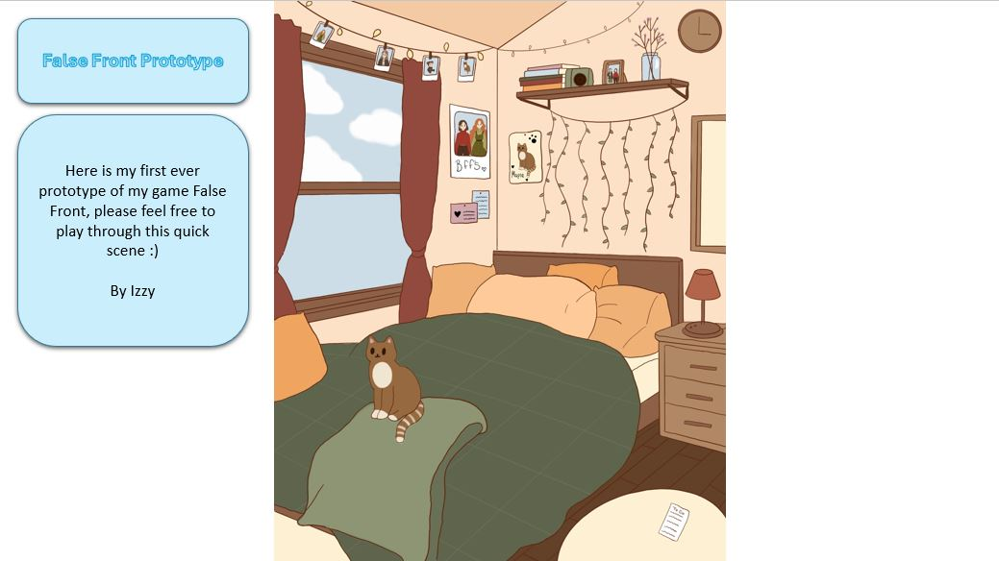

Slide 2
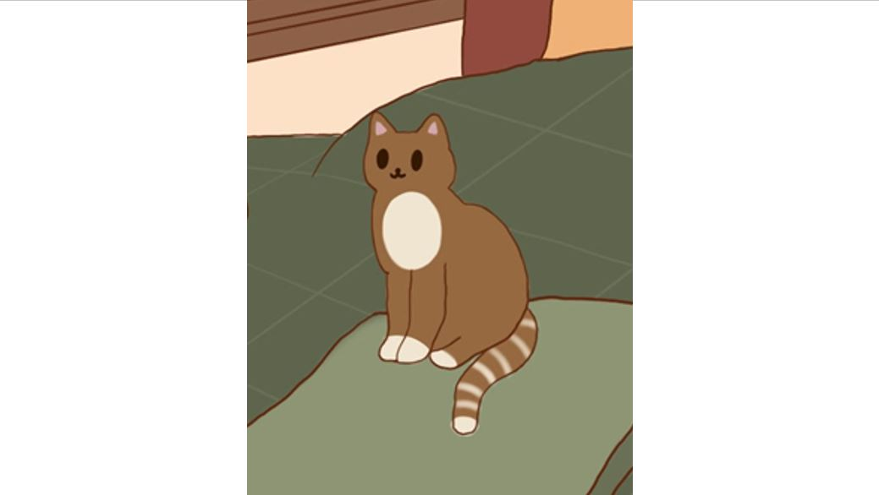


This is Maple, Maple means a lot to Emily and can always put her mind at ease

Slide 3
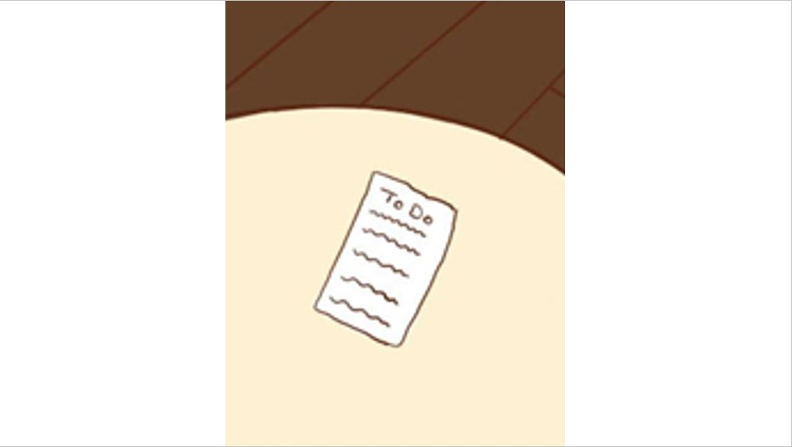
This is Emily’s daily to-do routine checklist

Slide 4
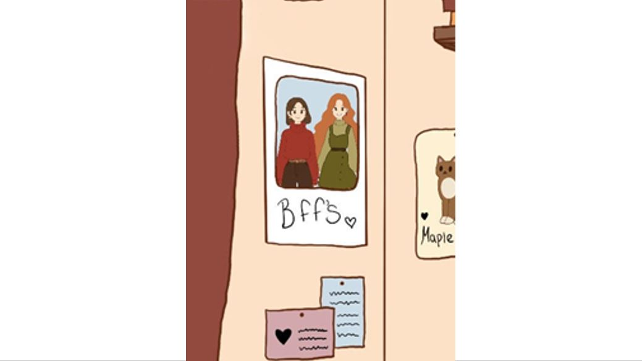
This is Robin & Emily they have been best friends since primary!

