Slide 1
Clean Disposal
A narrative-driven decision-making game about
responsibility, neglect, and irreversible consequences

Slide 2
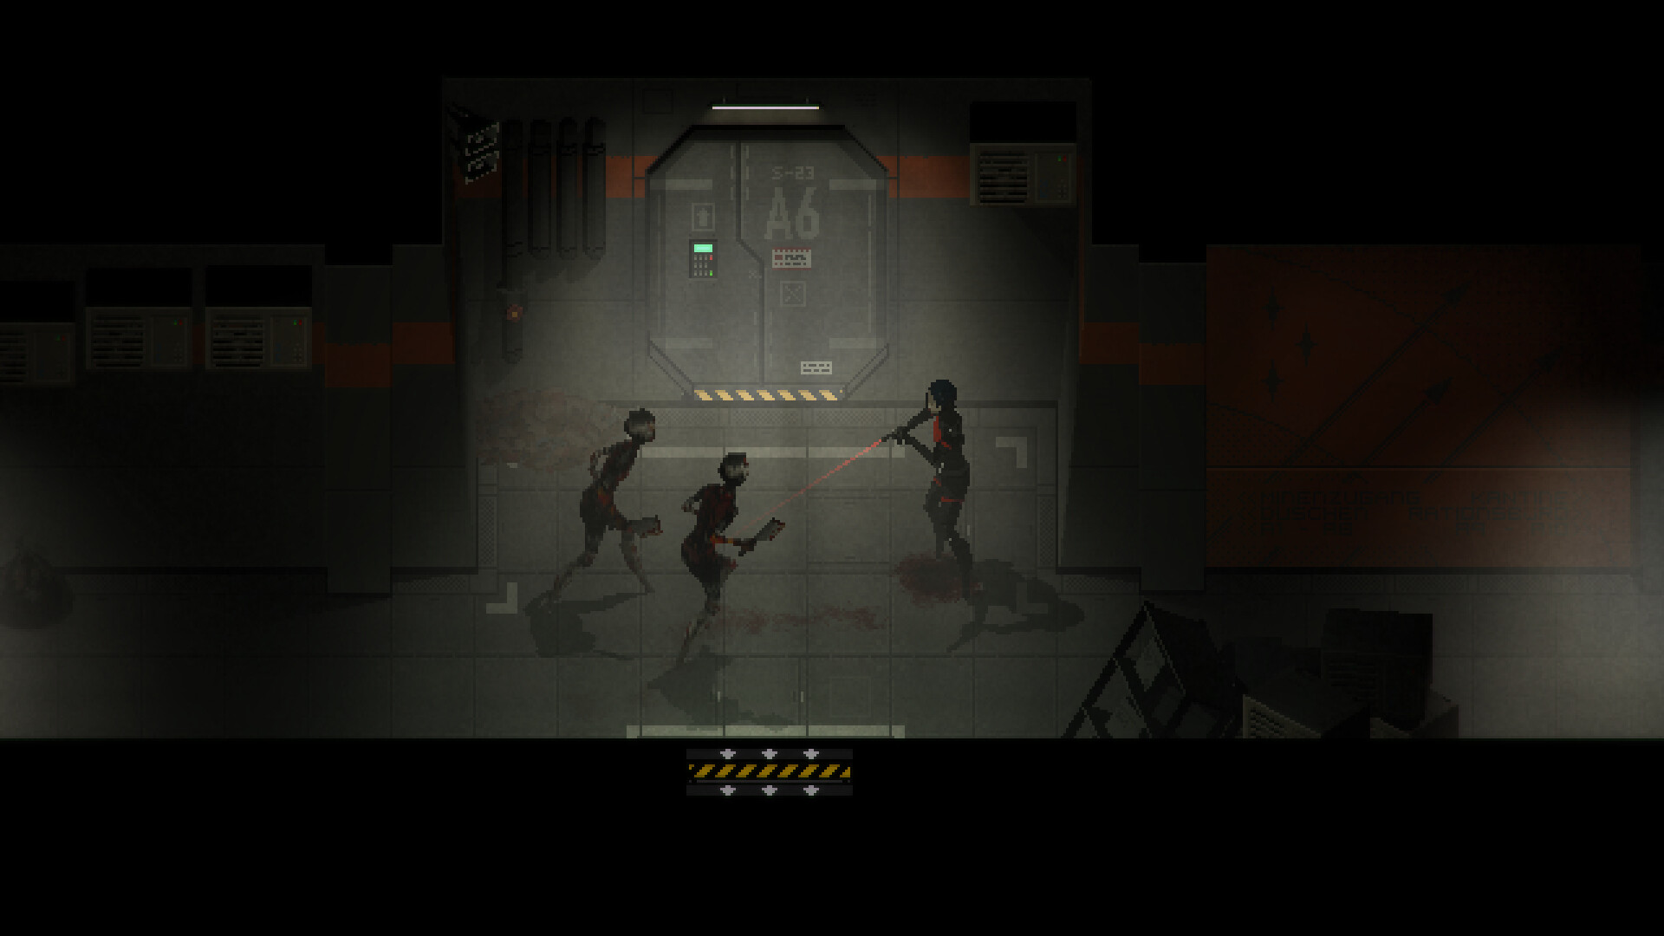
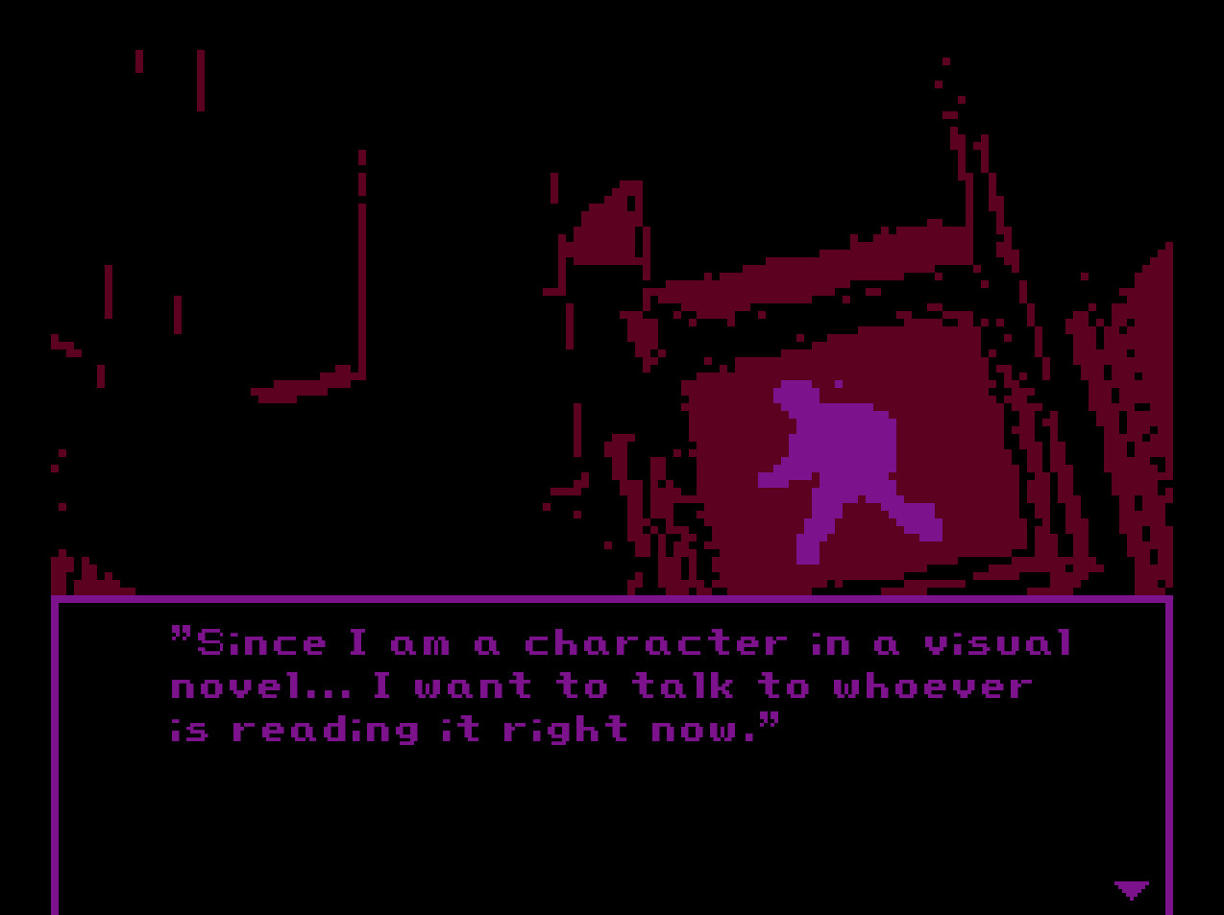
Target Audience
Age Rating: 16+ (for mature themes, psychological tension, and moral complexity)
Players who like social narratives, psychological suspense and slow-paced indie games
Players who prefer immersive moral choices and a lingering emotional impact experiences over fast-paced action
Reference: Signalis / Milk inside a bag of milk inside a bag of milk/Mouthwashing

Slide 3
Essential Experience
To feel clean, but not innocent
To clean the mess, only to realize you were part of it all along
I hope players can experience a quiet sense of guilt and reflection:
realizing how everyday actions, meant to fix or clean, can still cause unseen harm.
The quiet panic of realizing that trying to make things right has only made them worse.

Slide 4
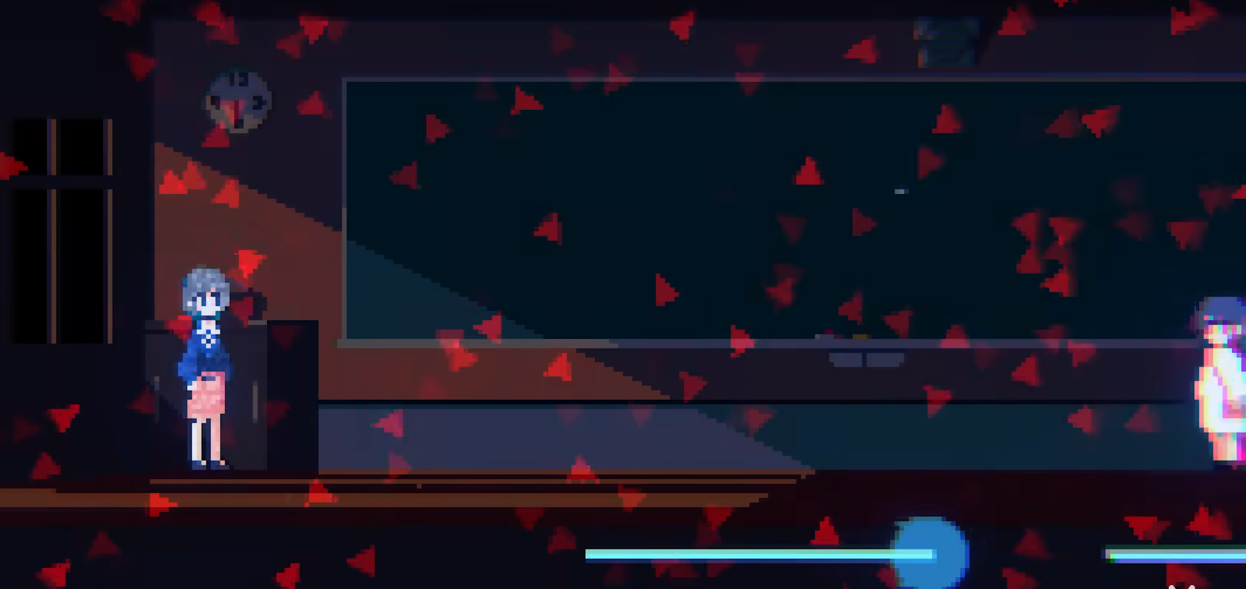
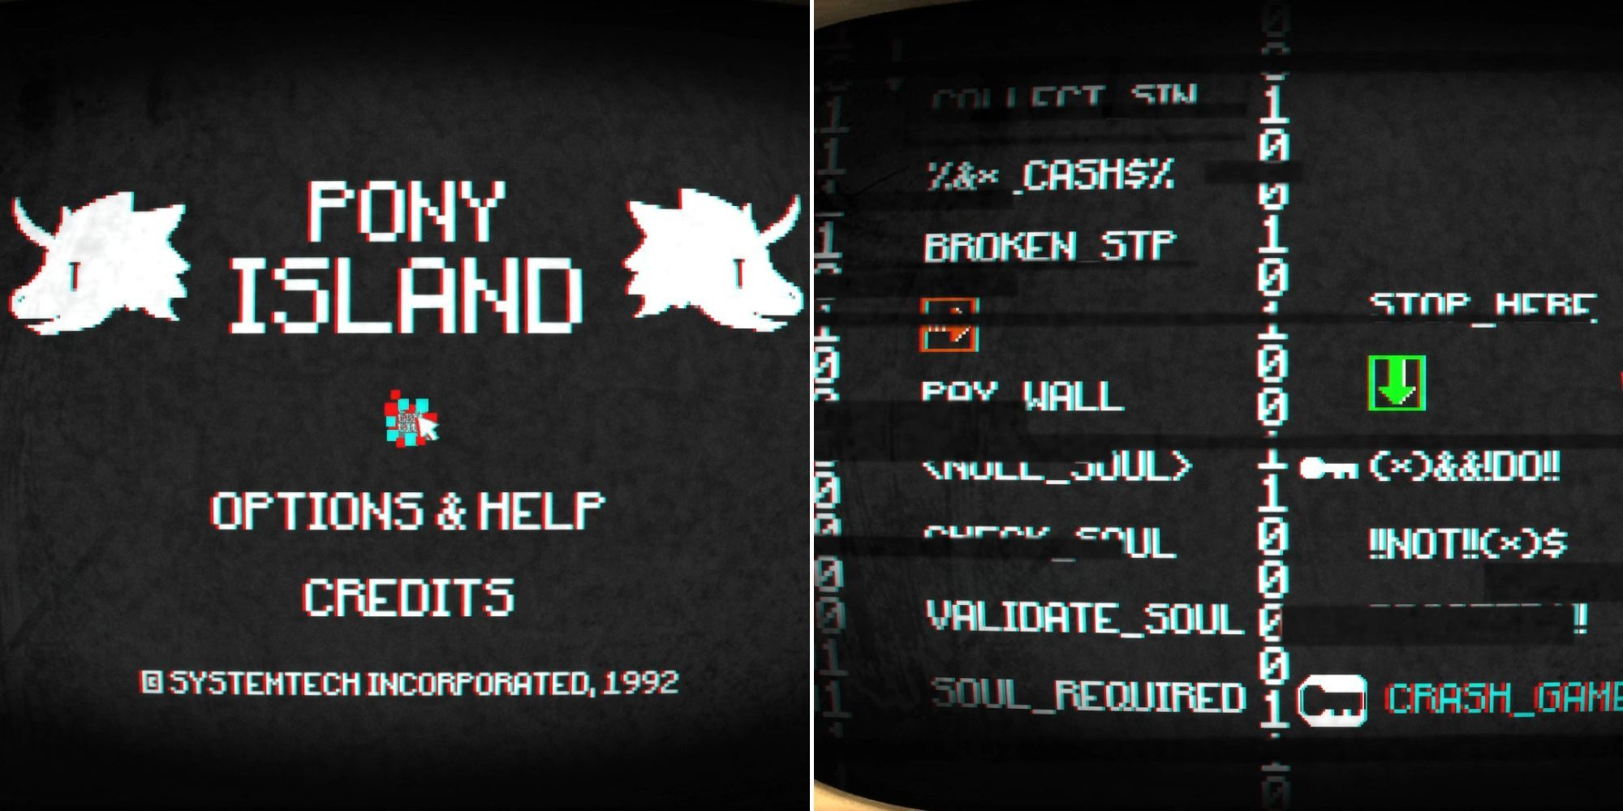
Design Intention
Tell story through objects & spaces: item descriptions and environmental details mutate over time to surface guilt (not exposition).
Minimize UI/feedback so players rely on observation and self-reflection rather than rewards or puzzle solves
The truth is hidden in unprompted details: the player spells out invisible clues while examining ordinary objects, and there are no quest hints. Truth is optional, but the guilt is not. The more they uncover, the less certain they become.
The system logic overlaps with the world logic: menus, saves, and errors all become stories.

Slide 5
Game Pillars
Pillar 1: Environmental Narratives and Mutation Guilt
Every detail of the world (objects, environmental text) is a narrative vector and will change subtly as the game progresses/player behavior, directly reflecting and evoking "guilt" feelings in the player.
Pillar 2: Unguided observation and self-discovery
Players must advance through the experience through active, meticulous observation, and the game never provides task lists, objective markers, or explicit "puzzle solved" feedback. The discovery of the truth depends entirely on the player's curiosity and associative ability.
Pillar 3: The system is the story, and the interface is the world
Every system element, menu, save and load file, or error — must mean something. It belongs to the game world, not outside it.

Slide 6
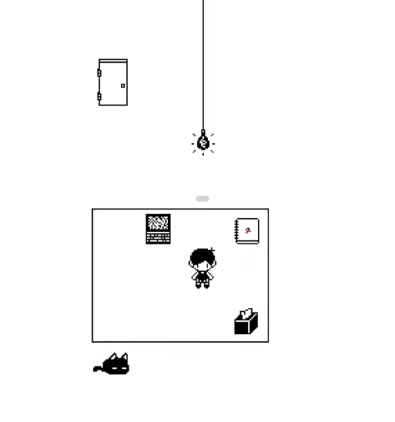
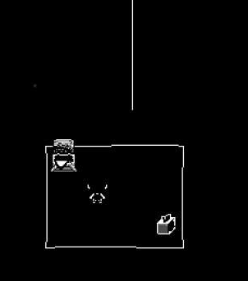
Game Pillars
Pillar 4: Daily Routine as Denial
Players repeat seemingly normal behaviors: going to school, going home, working—only to feel strange in the slightest changes.
Every cycle has a little change, tram delays, people taking time off, different news, school safety alert emails...... “Daily routine” It becomes a shell of denial, and the repetition itself maintains a false calm. Players will find that the "familiar scene" went a little bit wrong every round. This does not make them bored, but they start to fear the next day.

Slide 7
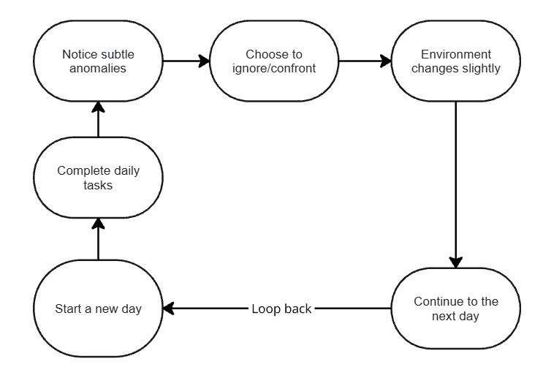
Core Game Loop

Slide 8
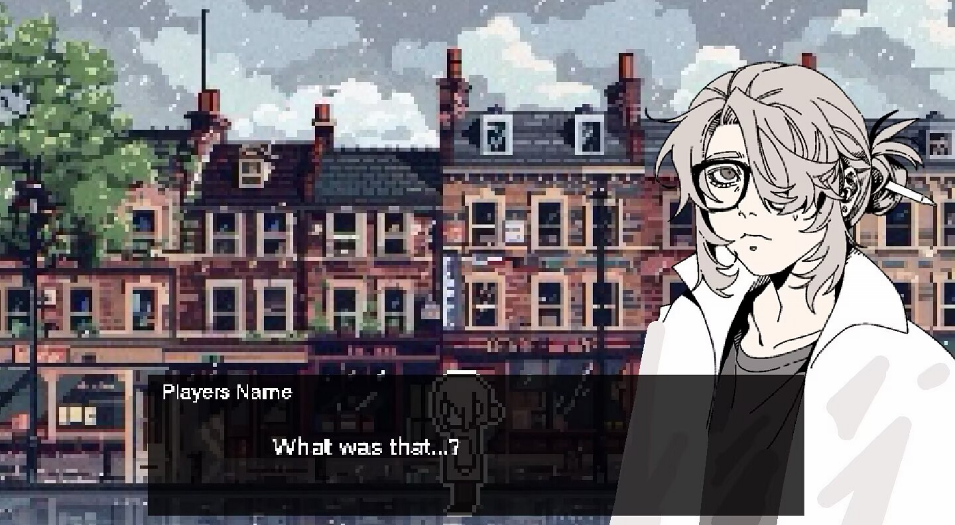
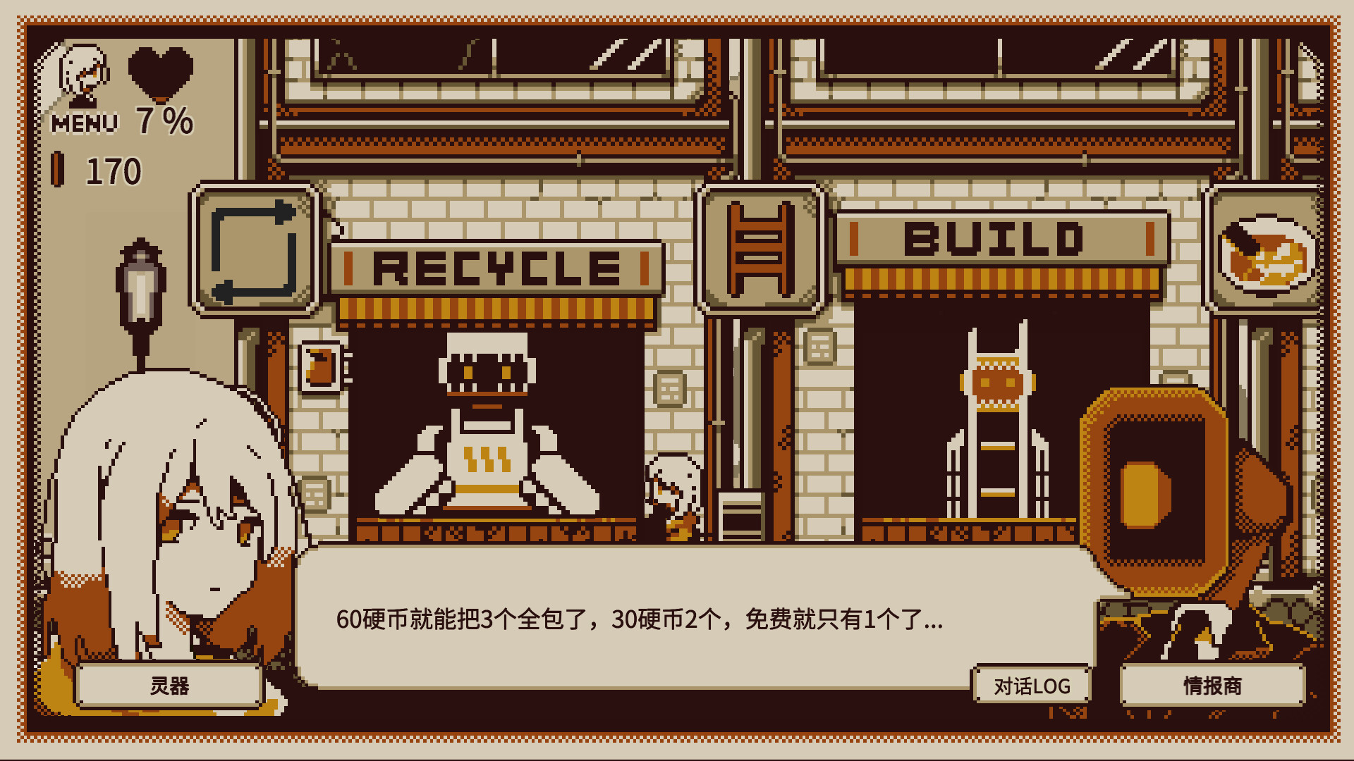
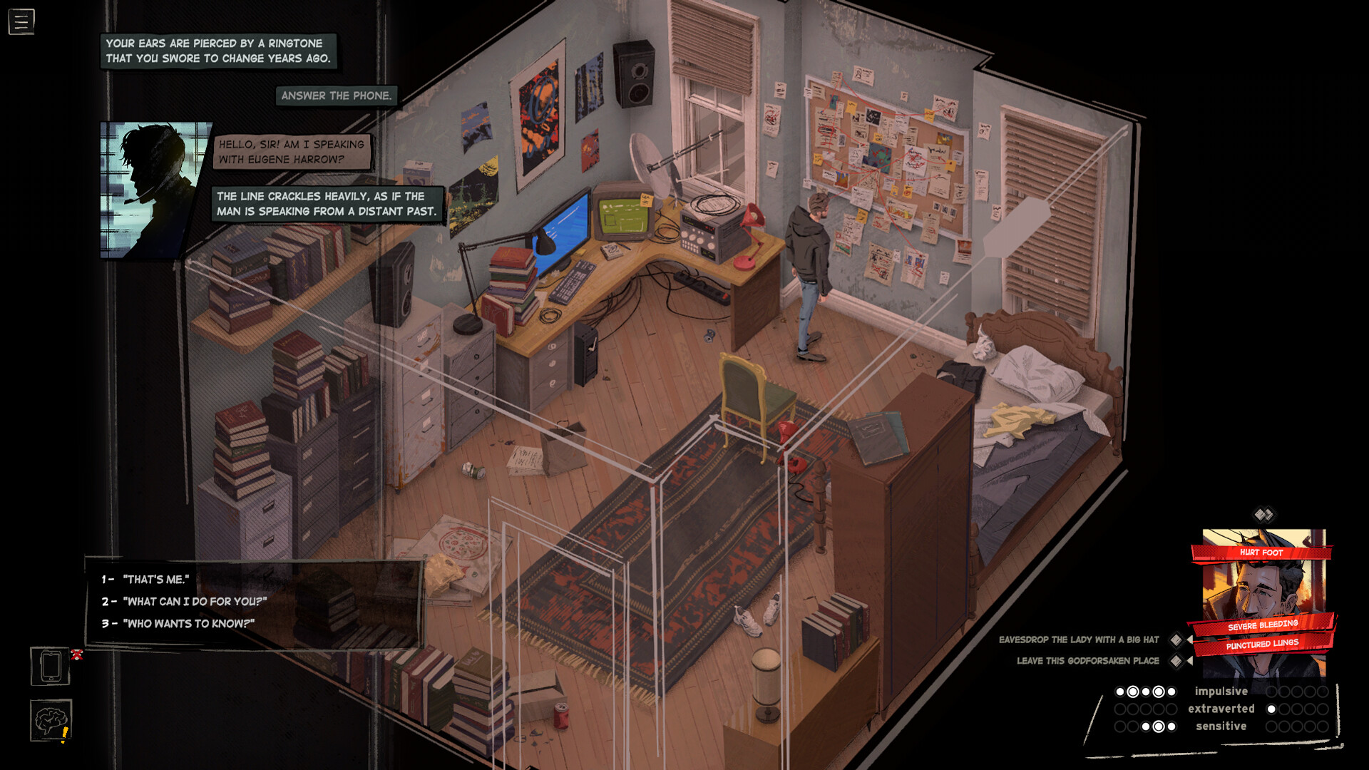
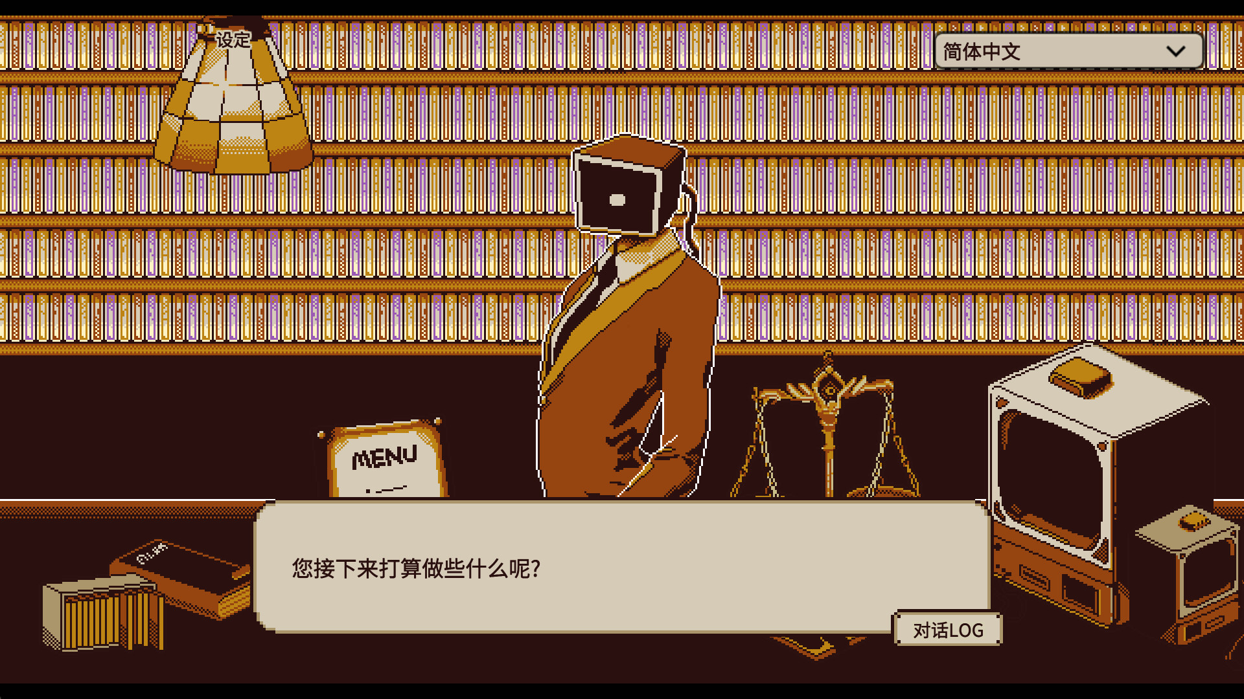
Visual Mock-up
Outside
Inside

Slide 9
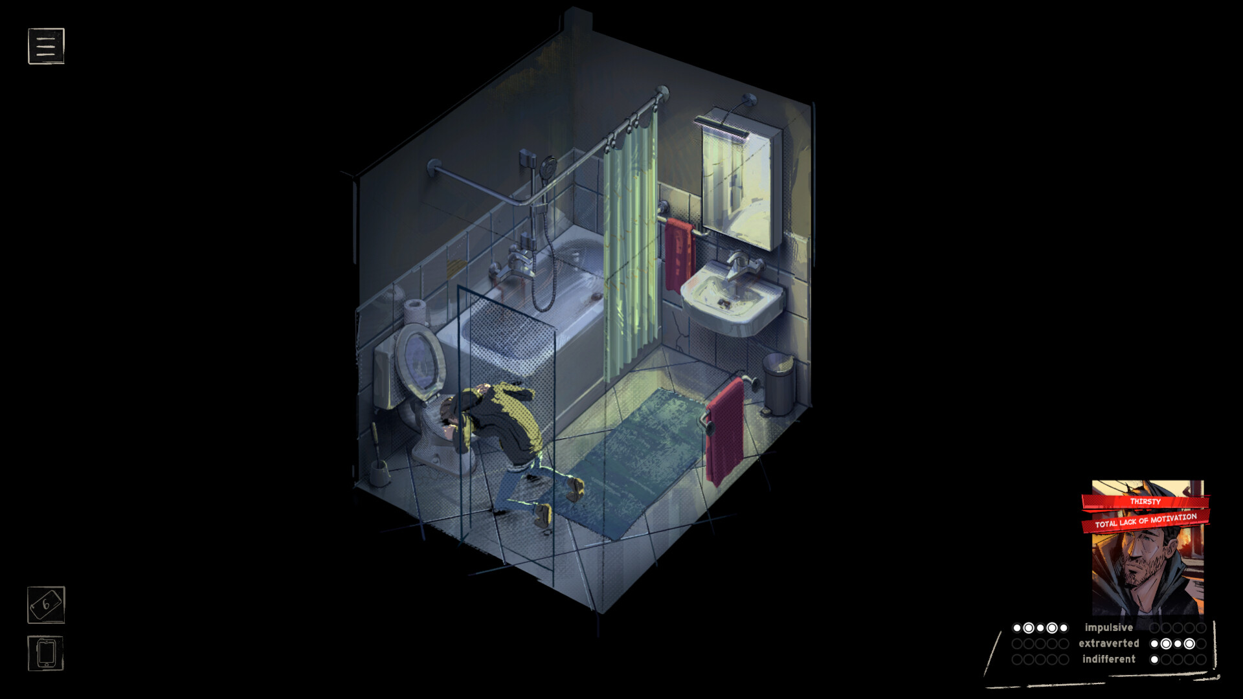
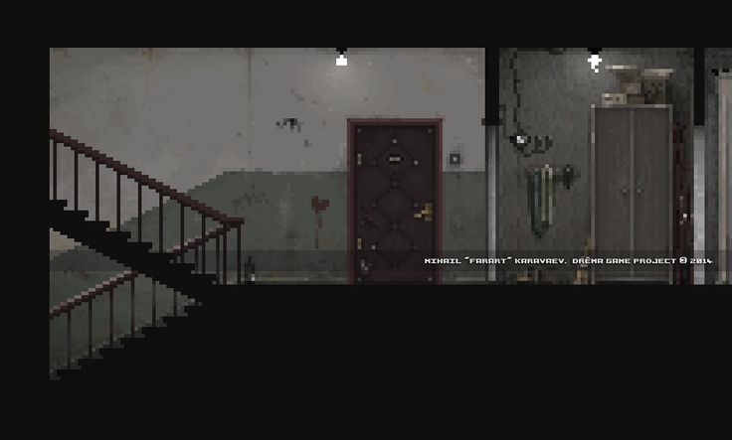
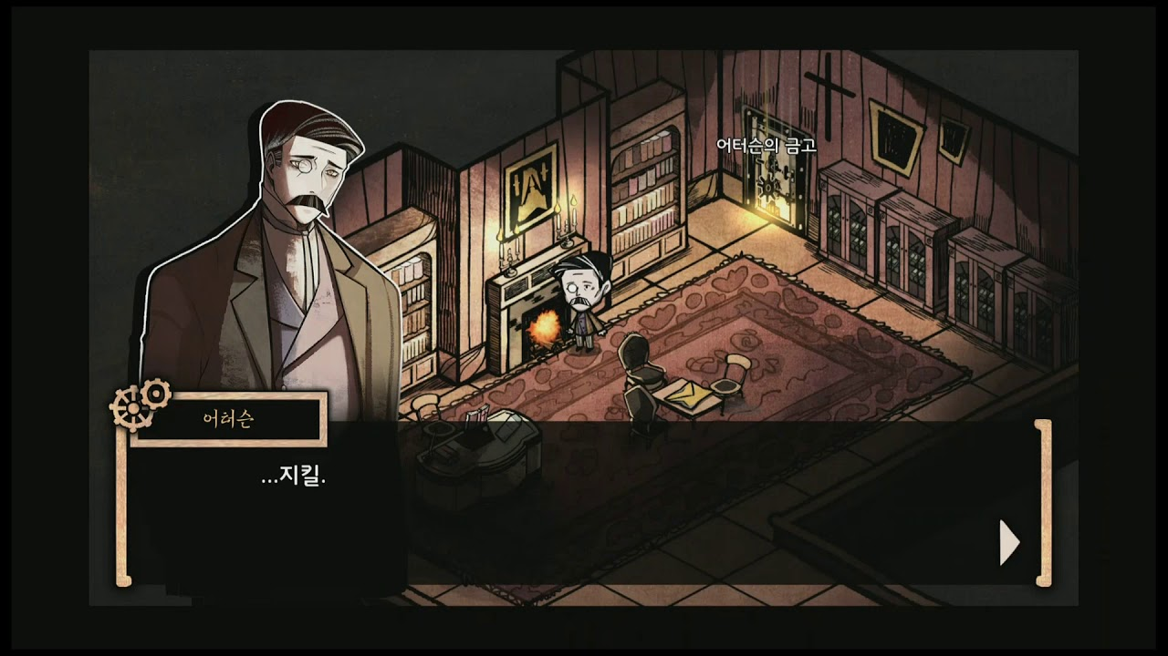
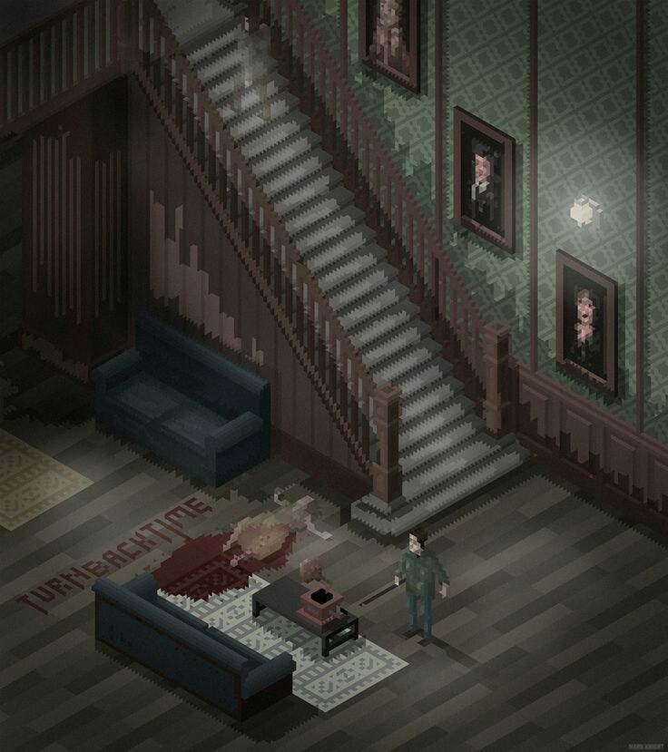
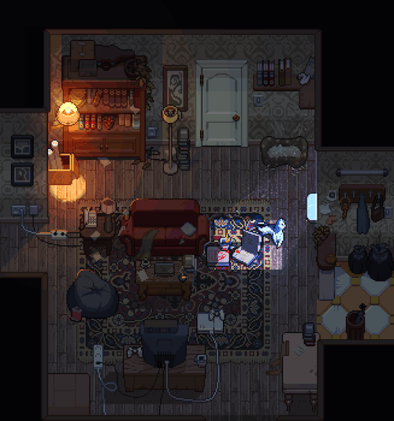
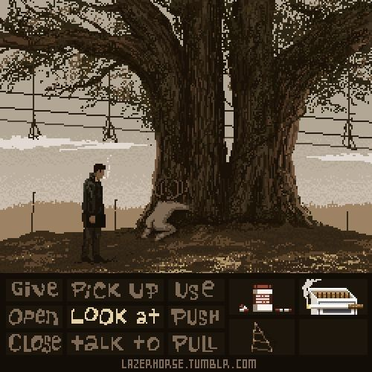
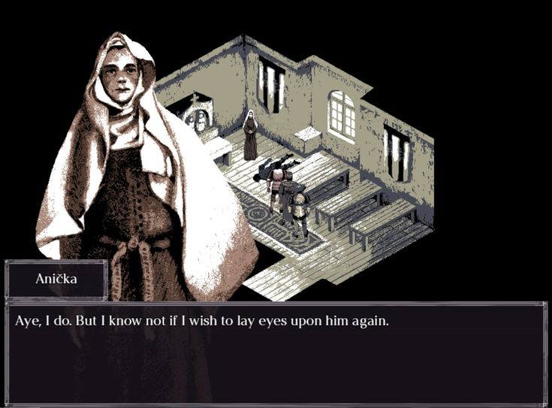
Moodboard

Slide 10

