Slide 1

Clean Disposal
To feel clean, but not innocent
To clean the mess, only to realize you were part of it all along

Slide 2
Target Audience
Age Rating: 16+ (for mature themes, psychological tension, and moral complexity)
Players who like social narratives, psychological suspense and slow-paced indie games
Players who prefer immersive moral choices and a lingering emotional impact experiences over fast-paced action
Tags:
Narrative Adventure/Psychological Thriller/Choice-Driven/Walking Simulator (Light)/Atmospheric

Slide 3
Essential Experience
An experience of quiet guilt and slow-burning tension
where every attempt to fix things only makes you look more suspicious
The player’s goal is to handle a small, harmless problem while trying to maintain a sense of normal life as misunderstandings escalate.
Players achieve this by observing subtle changes, making everyday choices, and navigating a world that continually misinterprets their intentions.

Slide 4
What Makes Clean Disposal Unique?
Misinterpretation as the core mechanic
— every reasonable action becomes suspicious.
Atmospheric feedback instead of UI
— news, lighting, and sound shift dynamically
A narrative where intention and perception constantly collide
—You act normally—yet it looks suspicious

Slide 5
Production Scope
Small-scale environments
(apartment, street corner, forest path)
Light interaction system
(inspect, pick up, observe, simple choices)
Dynamic atmospheric feedback
(news changes, sound shifts, lighting cues)
Simple narrative scripting
No combat, no complex puzzles
(low technical demand)
Focus on mood, pacing, and player interpretation

Slide 6
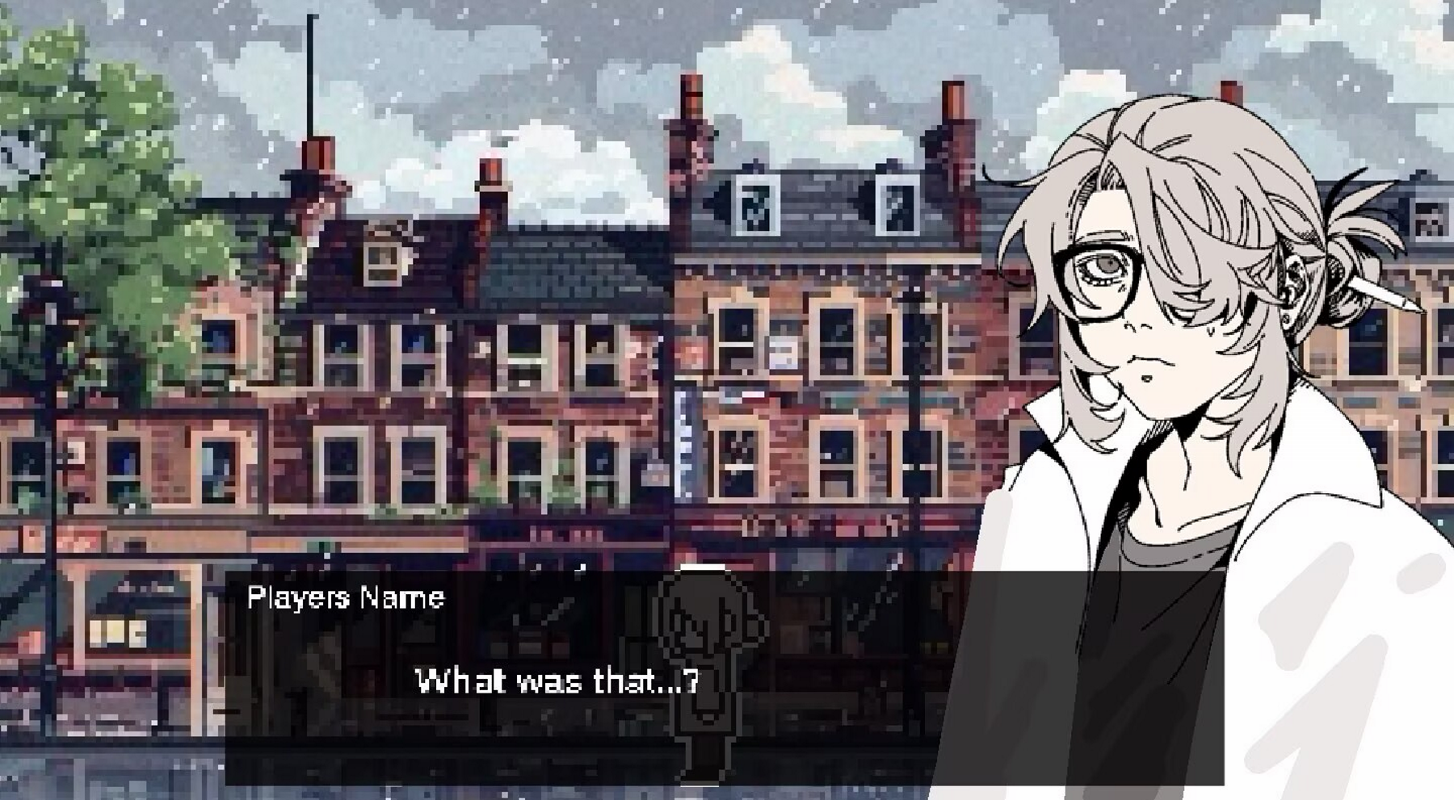
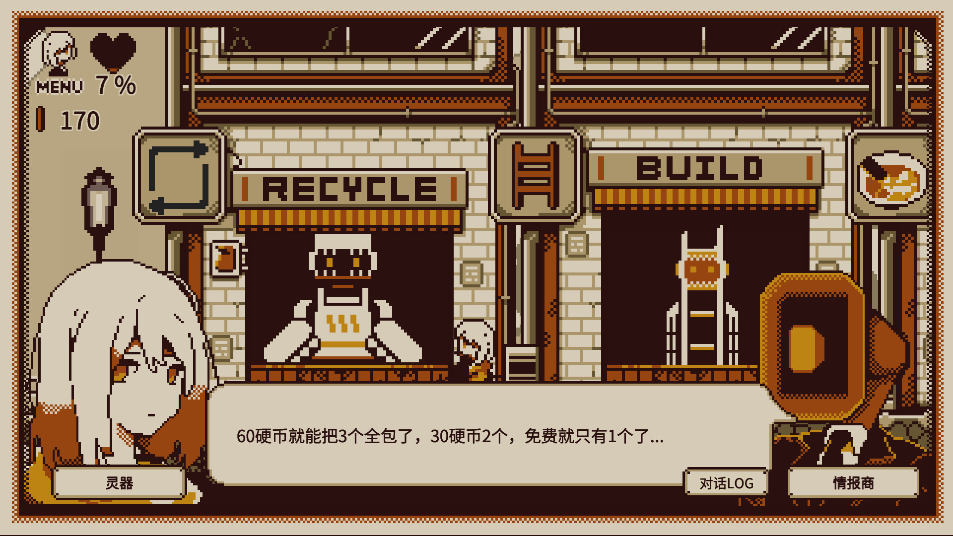
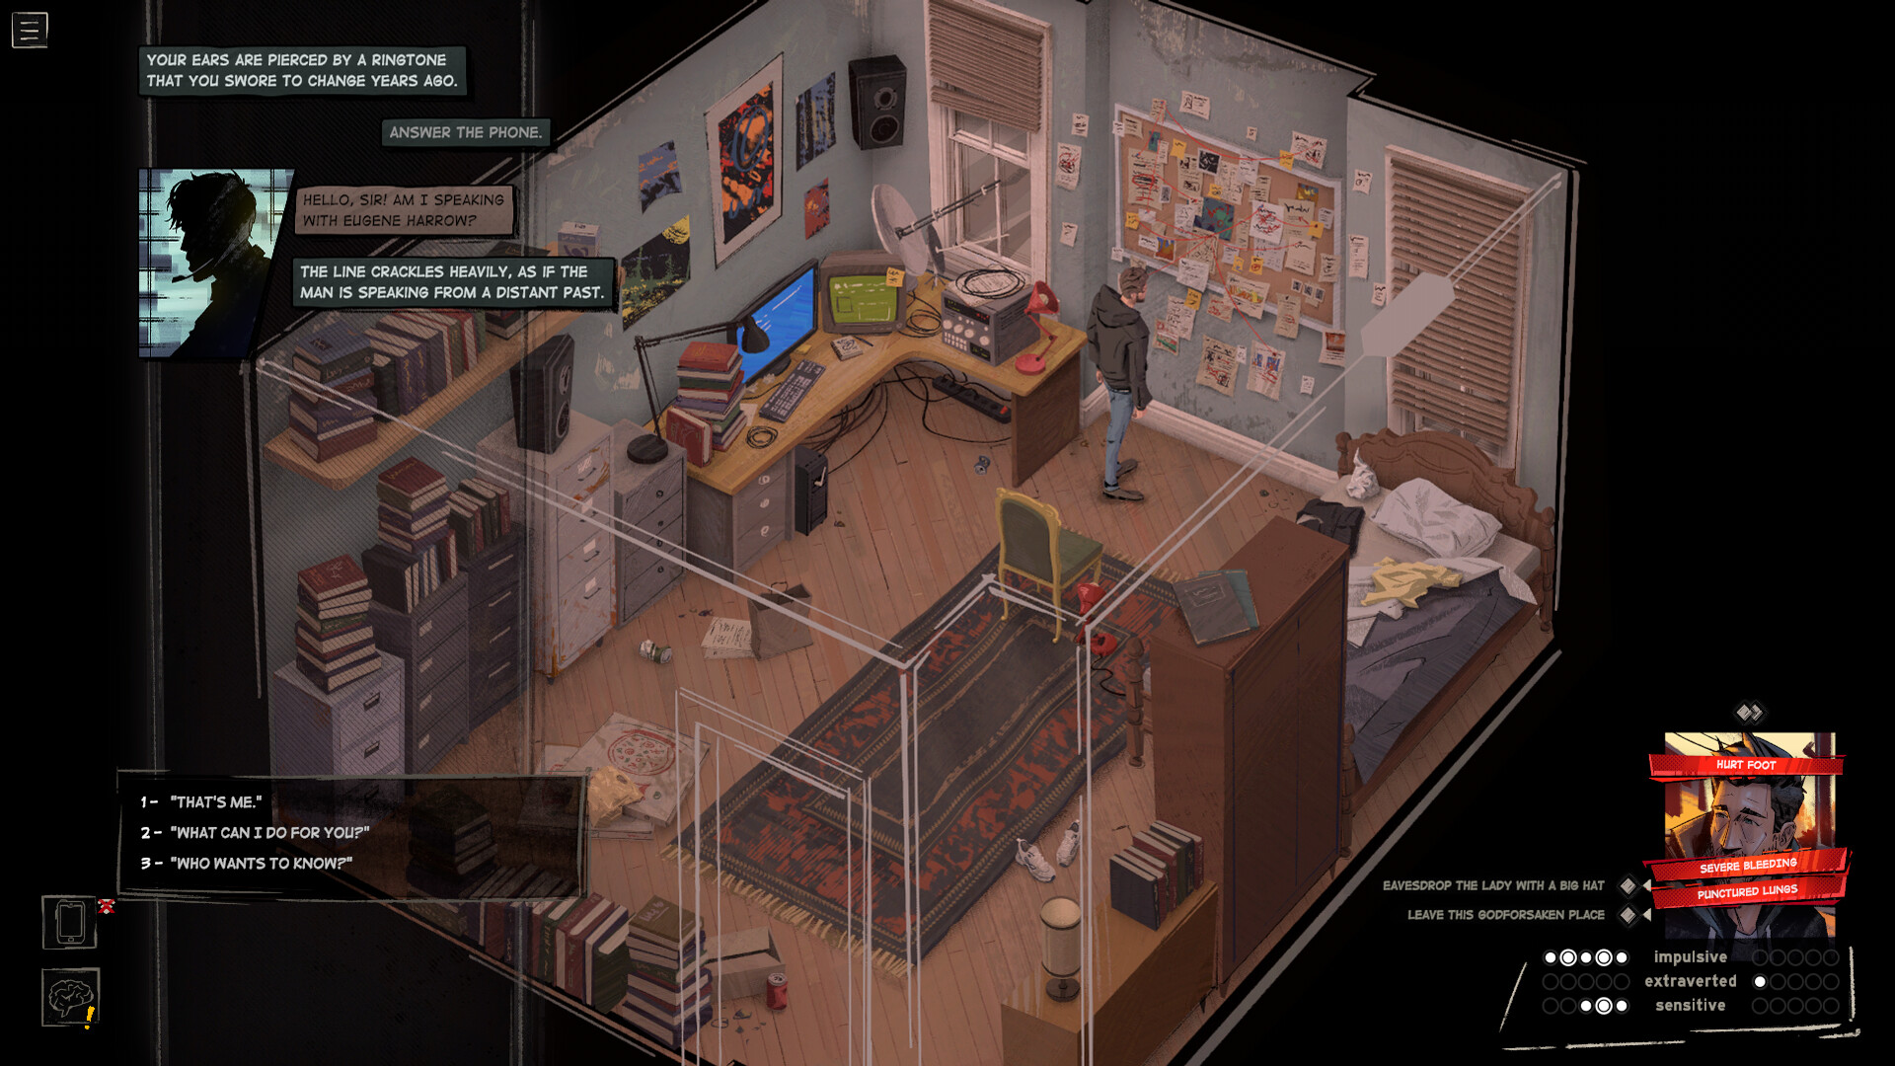
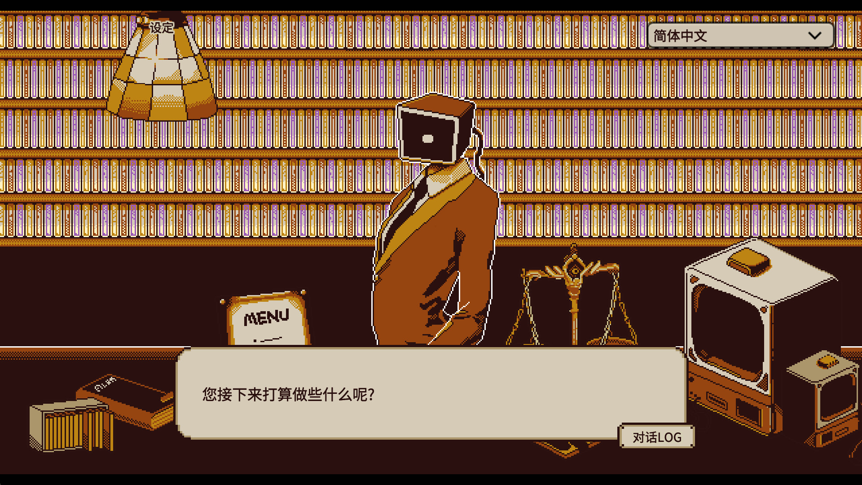
Visual Mock-up
Outside
Inside

Slide 7
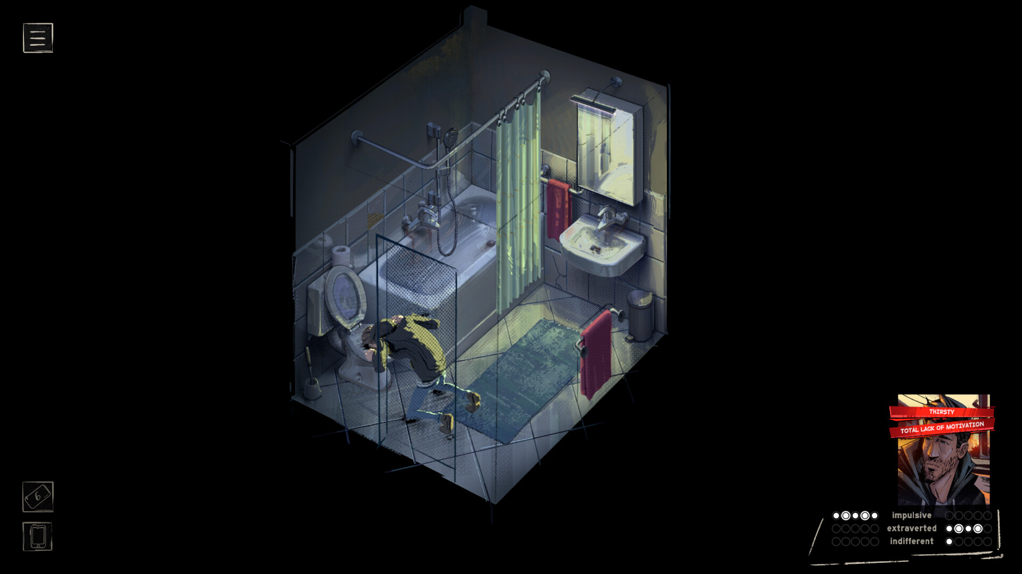
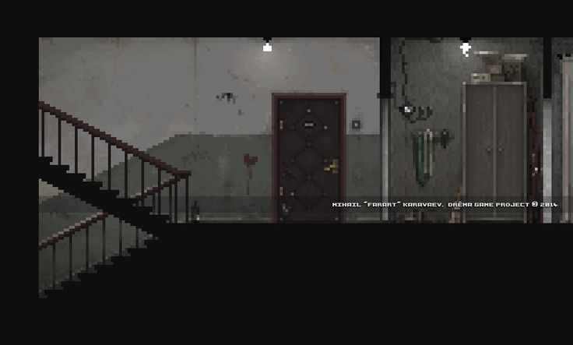
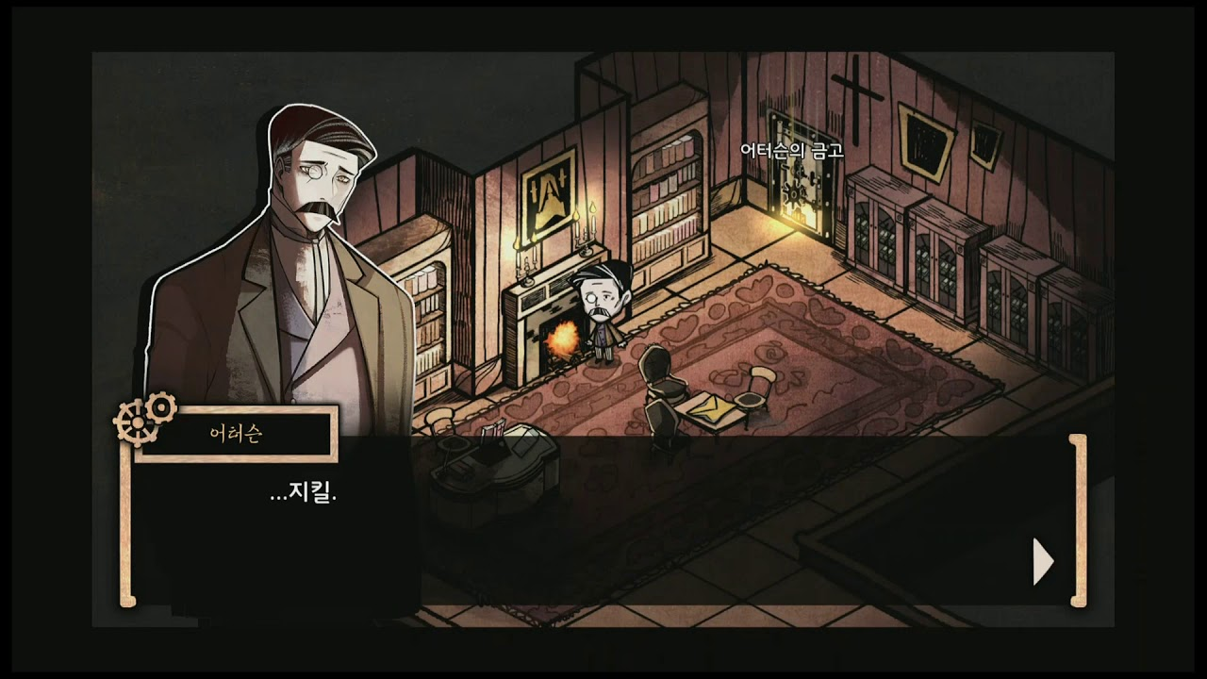
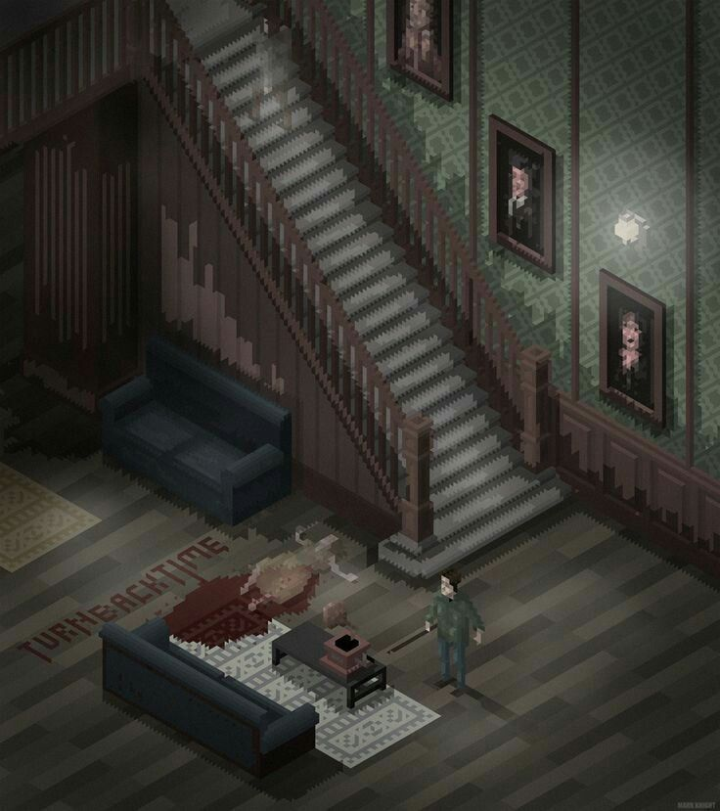
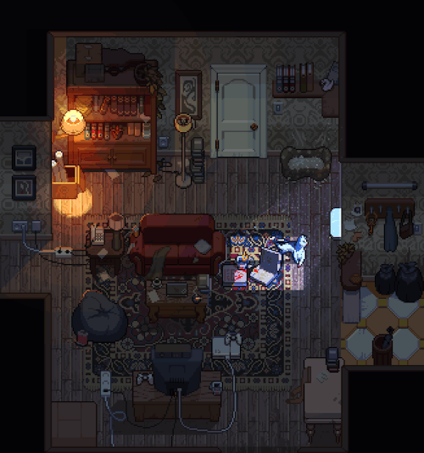
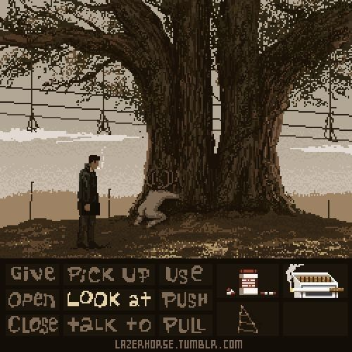
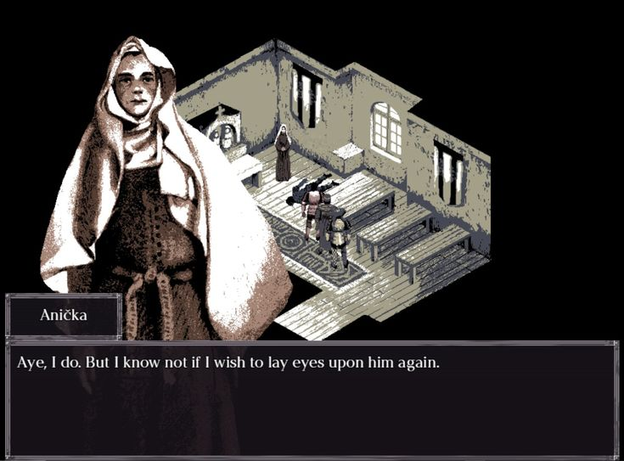
Moodboard

Slide 8
