Slide 1
My Topics YAAY!!
Paula Vales

Slide 2
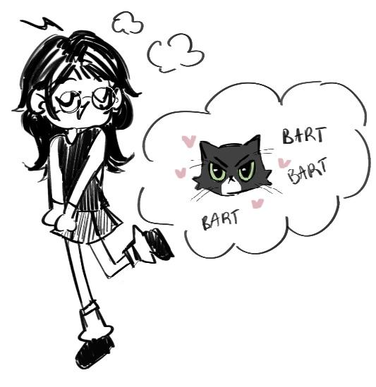
Topics I’m Covering :333
Parisian Catacombs
Parasocial Relationships
Animals in Space
Salem Witch Trials

Slide 3


Parisian Catacombs
The history of the Parisian catacombs start around the 18th century when France was plagued with public health problems due to the cemeteries overflowing. To fix this problem, France found a quick solution within the former Tombe-Issoire quarries built by the Romans. Here, they stored the bones of human remains. The labyrinth of connecting tunnels spread over 150 miles.

Slide 4
Cataphiles or
“Mole people”

Slide 5
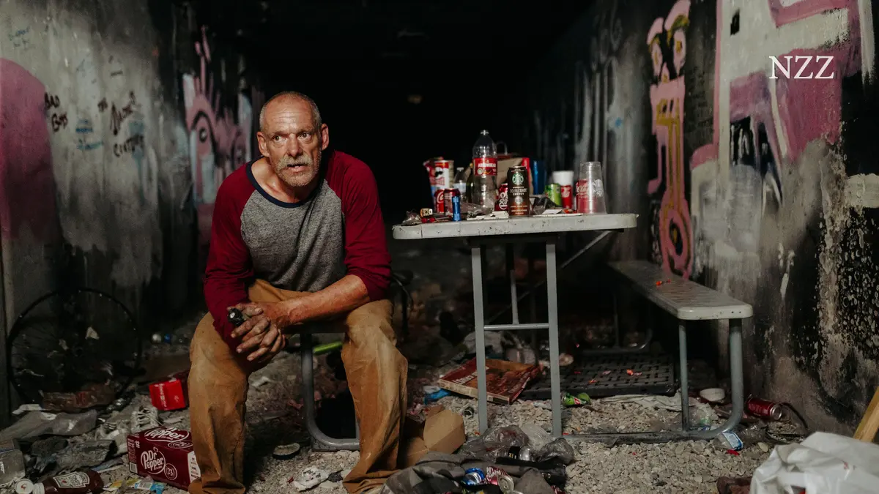
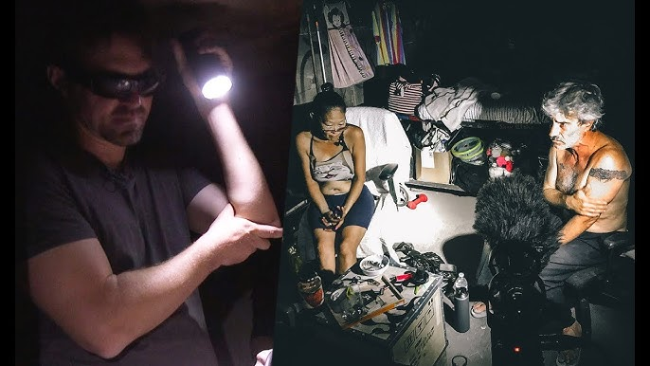
Although only a fraction of the catacombs is open to the public, there are illegal urban explorers that wander through these endless passageways.
Some of these explorers create art, map out the tunnels or hold secret raves / parties.
There’s a special police force that patrol the tunnels to stop illegal entry, however these explorers keep finding other ways in.

Slide 6
Symbolism and meaning in the Catacombs

Slide 7
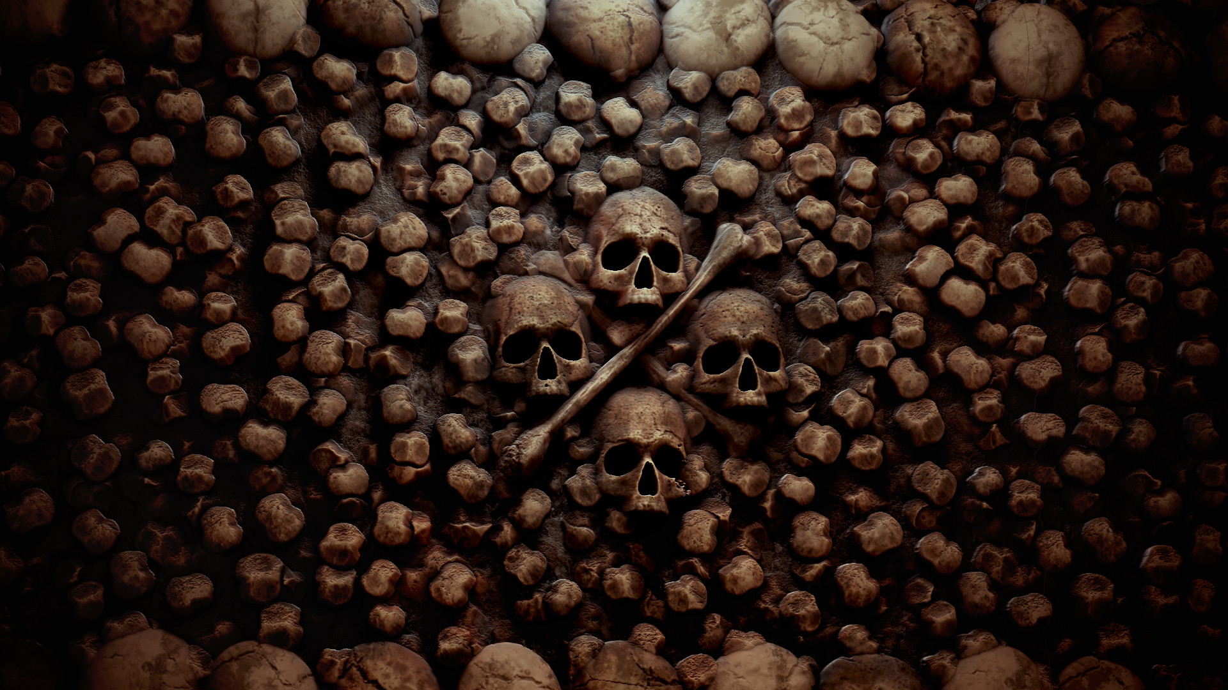
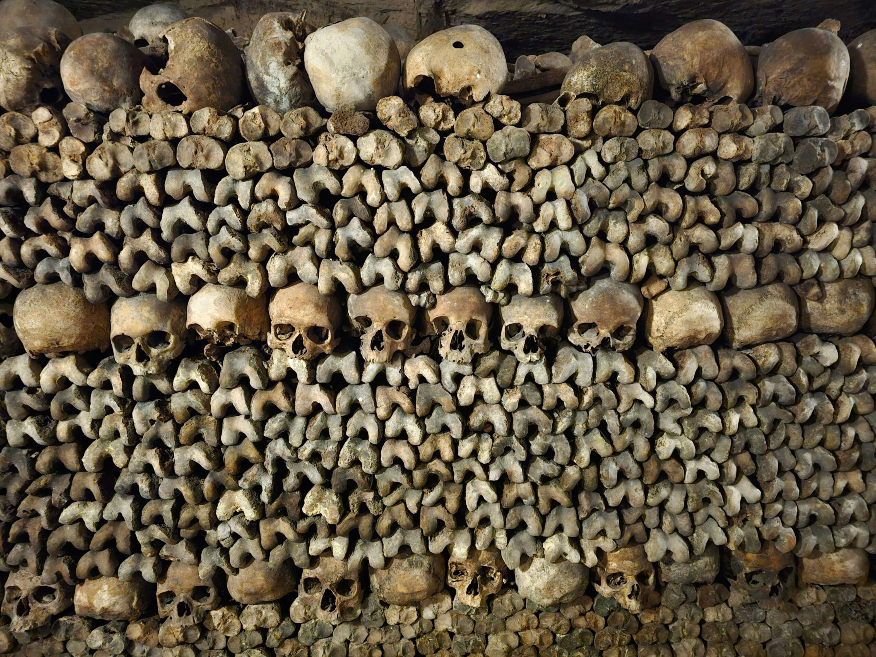
Upon entering the catacombs (the legal way), visitors will be greeted with a chilling inscription: Arrête, c'est ici l'empire de la Mort which translates to, “Stop, this is the realm of death.”
Within the ossuary, there is an absence of headstones. Various people of different social standings lay next to each other.
The catacombs is a metaphor for equality in death. The bones of a noble could be next to a peasant, but you would never know since their bones look exactly the same.

Slide 8
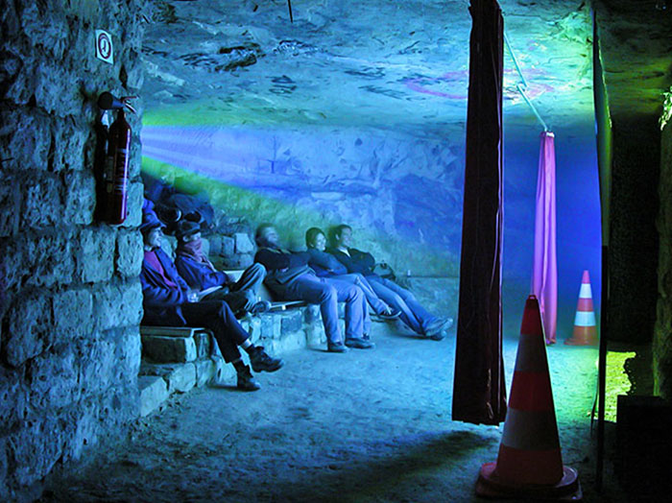
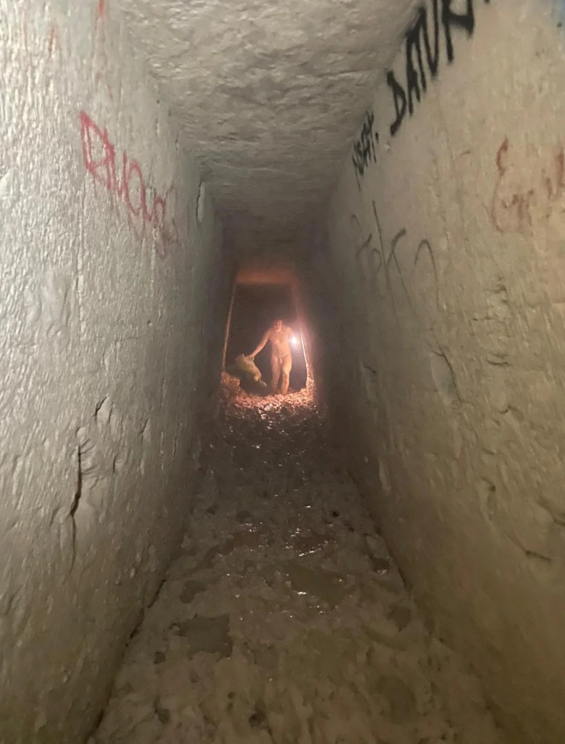
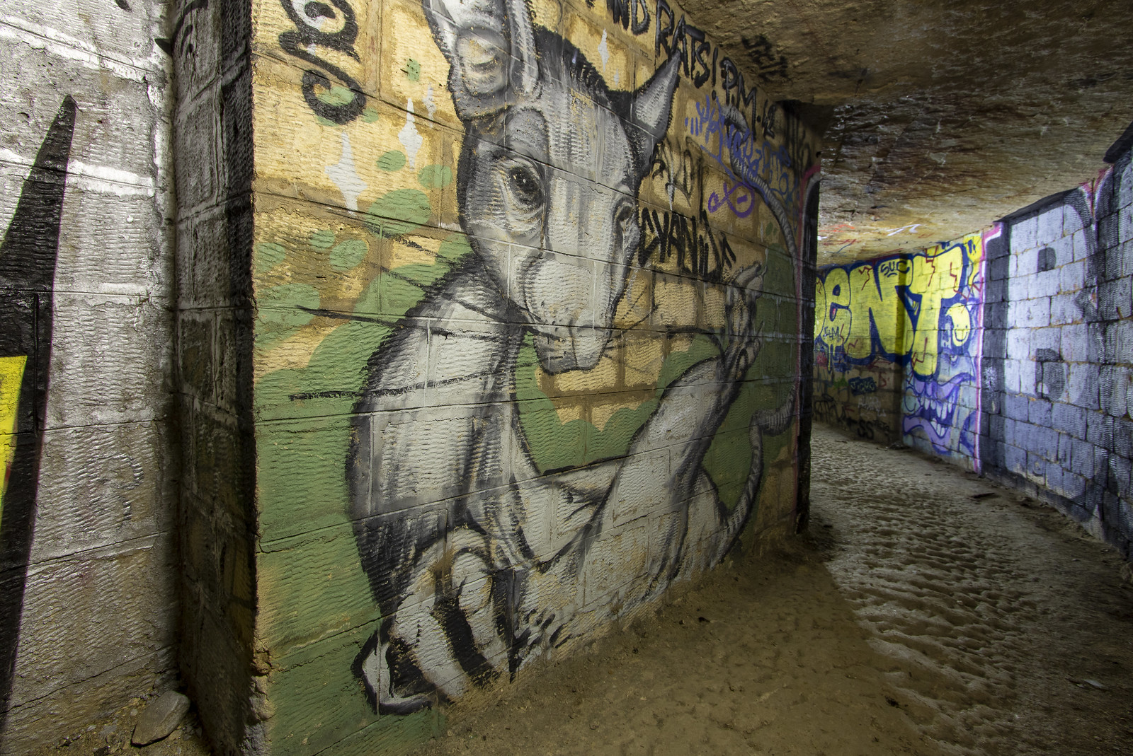
You can expect to encounter:
The occasional naked man ew
Secret raves or parties
Drug users
Cataphiles duh
Artists

Slide 9
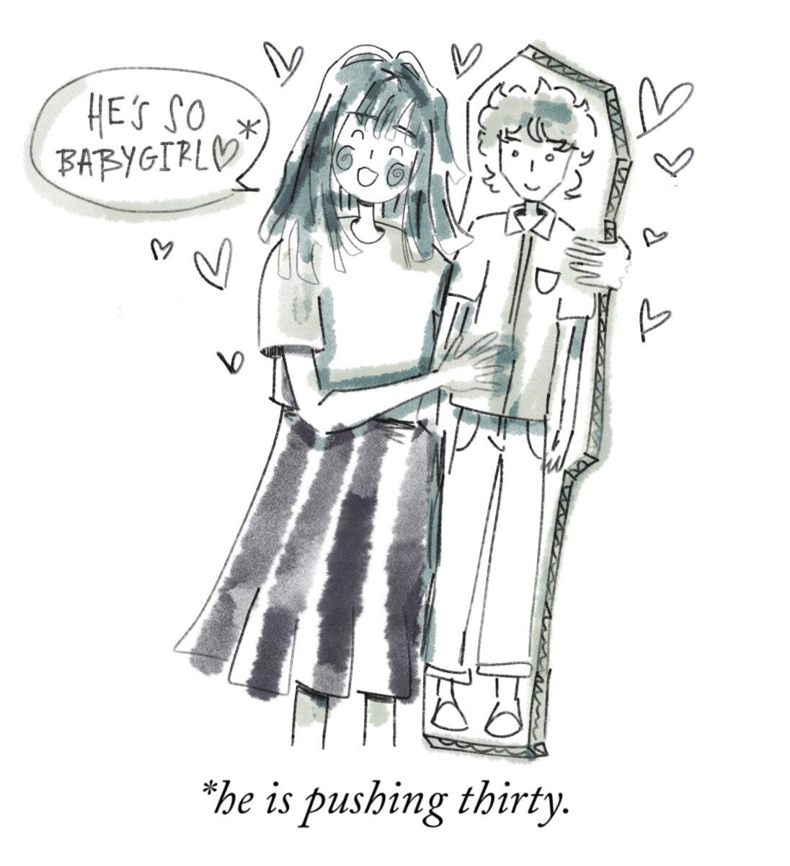
Parasocial Relationships
And its consequences
Parasocial relationships
It is a one sided relationship in which one person develops a strong sense of connection, intimacy or familiarity with someone they don’t know. These are mostly celebrities or internet figures. (Psychology Today Staff, 2025)

Slide 10
A Quick Dive into the Korean Idol Industry

Slide 11
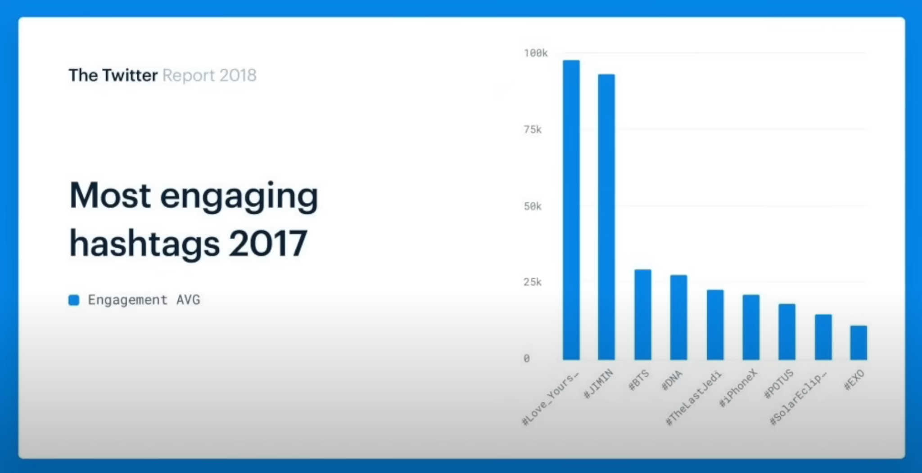
Figure shows the trending tags in Twitter across the world in 2017. The top 4 are all BTS related and shows how dedicated some of these fans are.

Slide 12

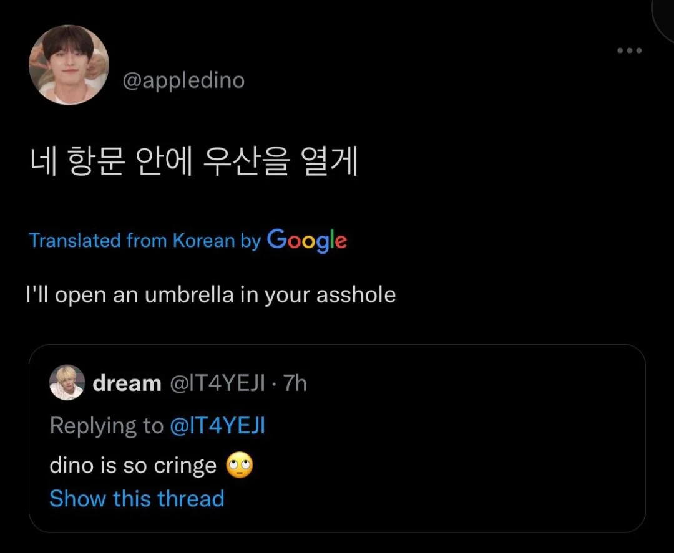
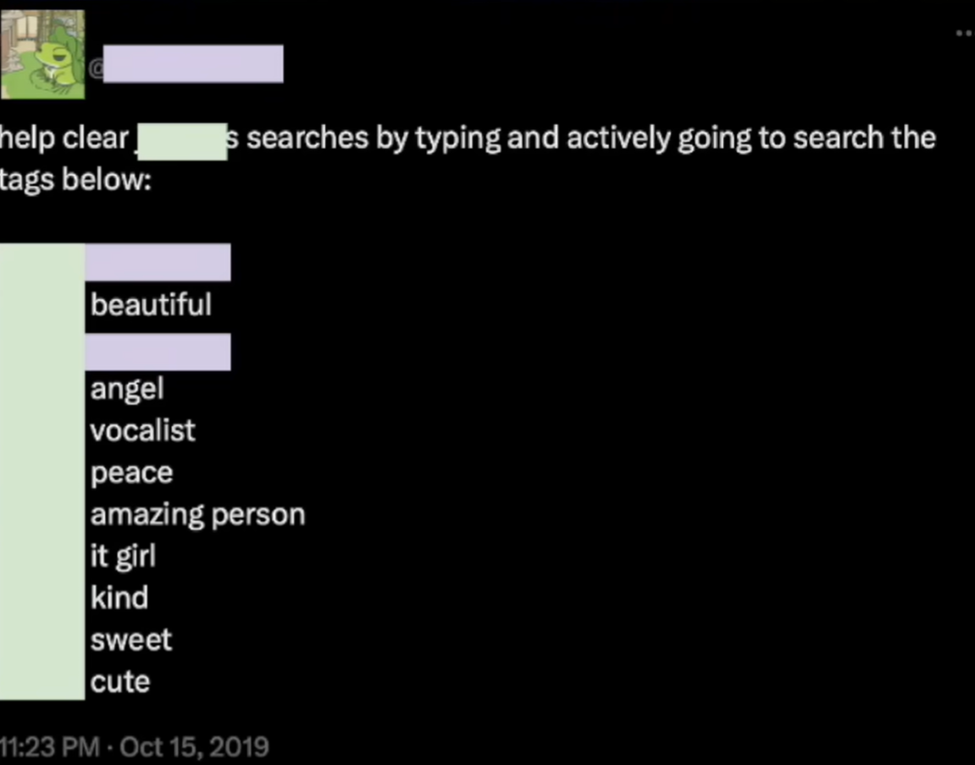
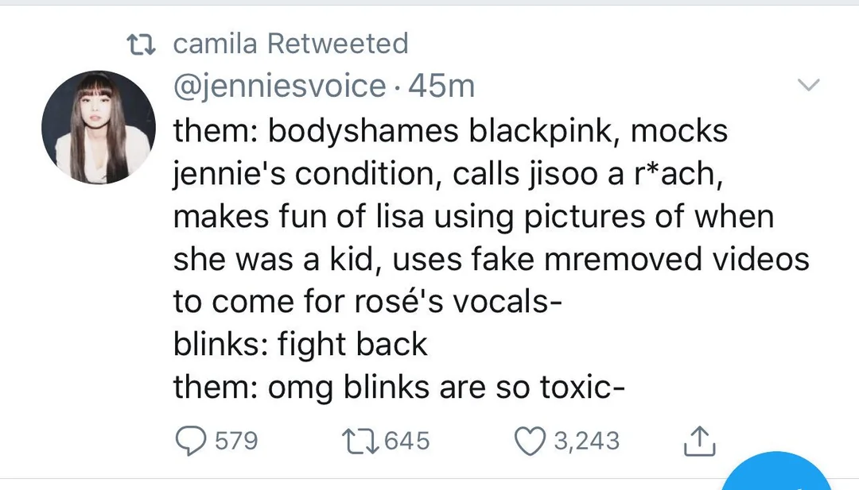
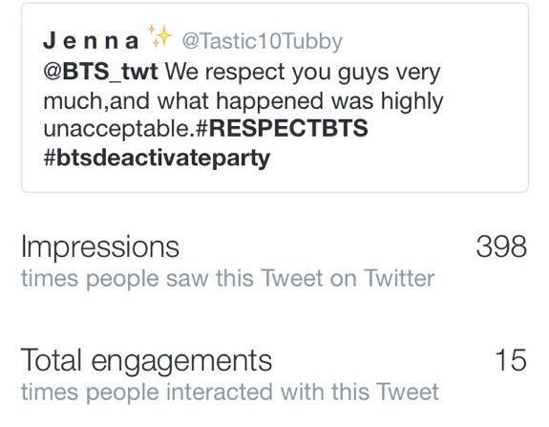
Fancom - Is a system in which the fans manage their idol’s growth so that they flourish and reach other audiences.
They participate in fundraising and charity work to make sure their idol’s image is enhanced.
Fancom practices include fans feeling compelled to police the content on social media, especially if it risks the idol’s image. They will spam certain keywords to trick the algorithm to make the keywords trend instead of the scandal. (Aini, 2023)

Slide 13
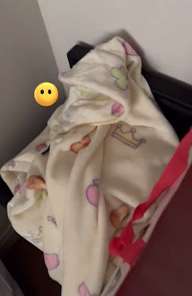
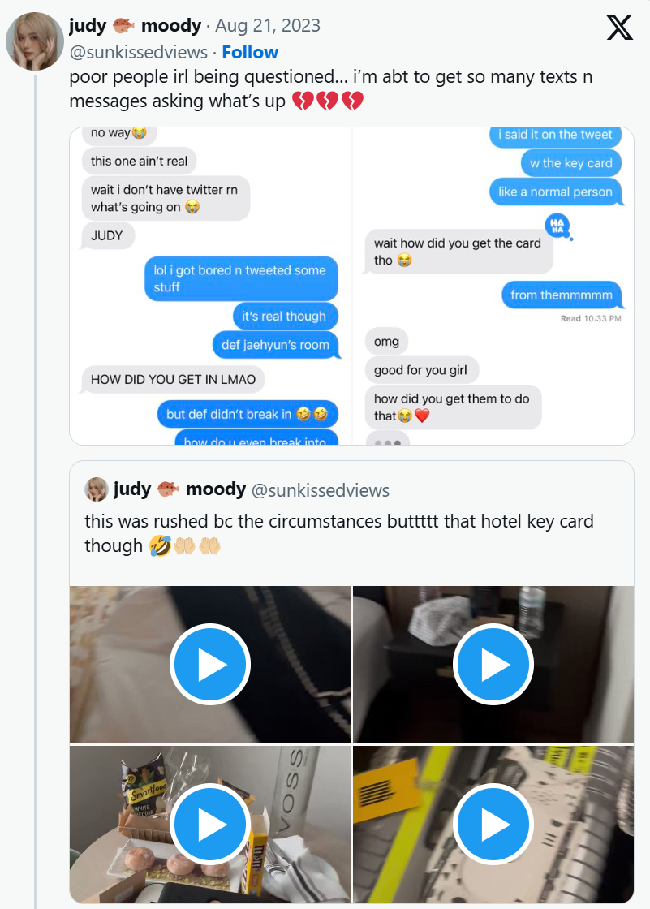
Sasaeng - a term in Korea for obsessive fans that overstep their boundaries and invade a celebrity’s personal life.
In August of 2023, a stalker (saesang) broke into an NCT’s hotel suite during the US NCT tour and recorded the entire crime on video as well as uploaded it on Twitter.
After other fans had watched the video, they noticed that the pajamas in the video were the same ones the idol had worn in the official NCT channel.

Slide 14
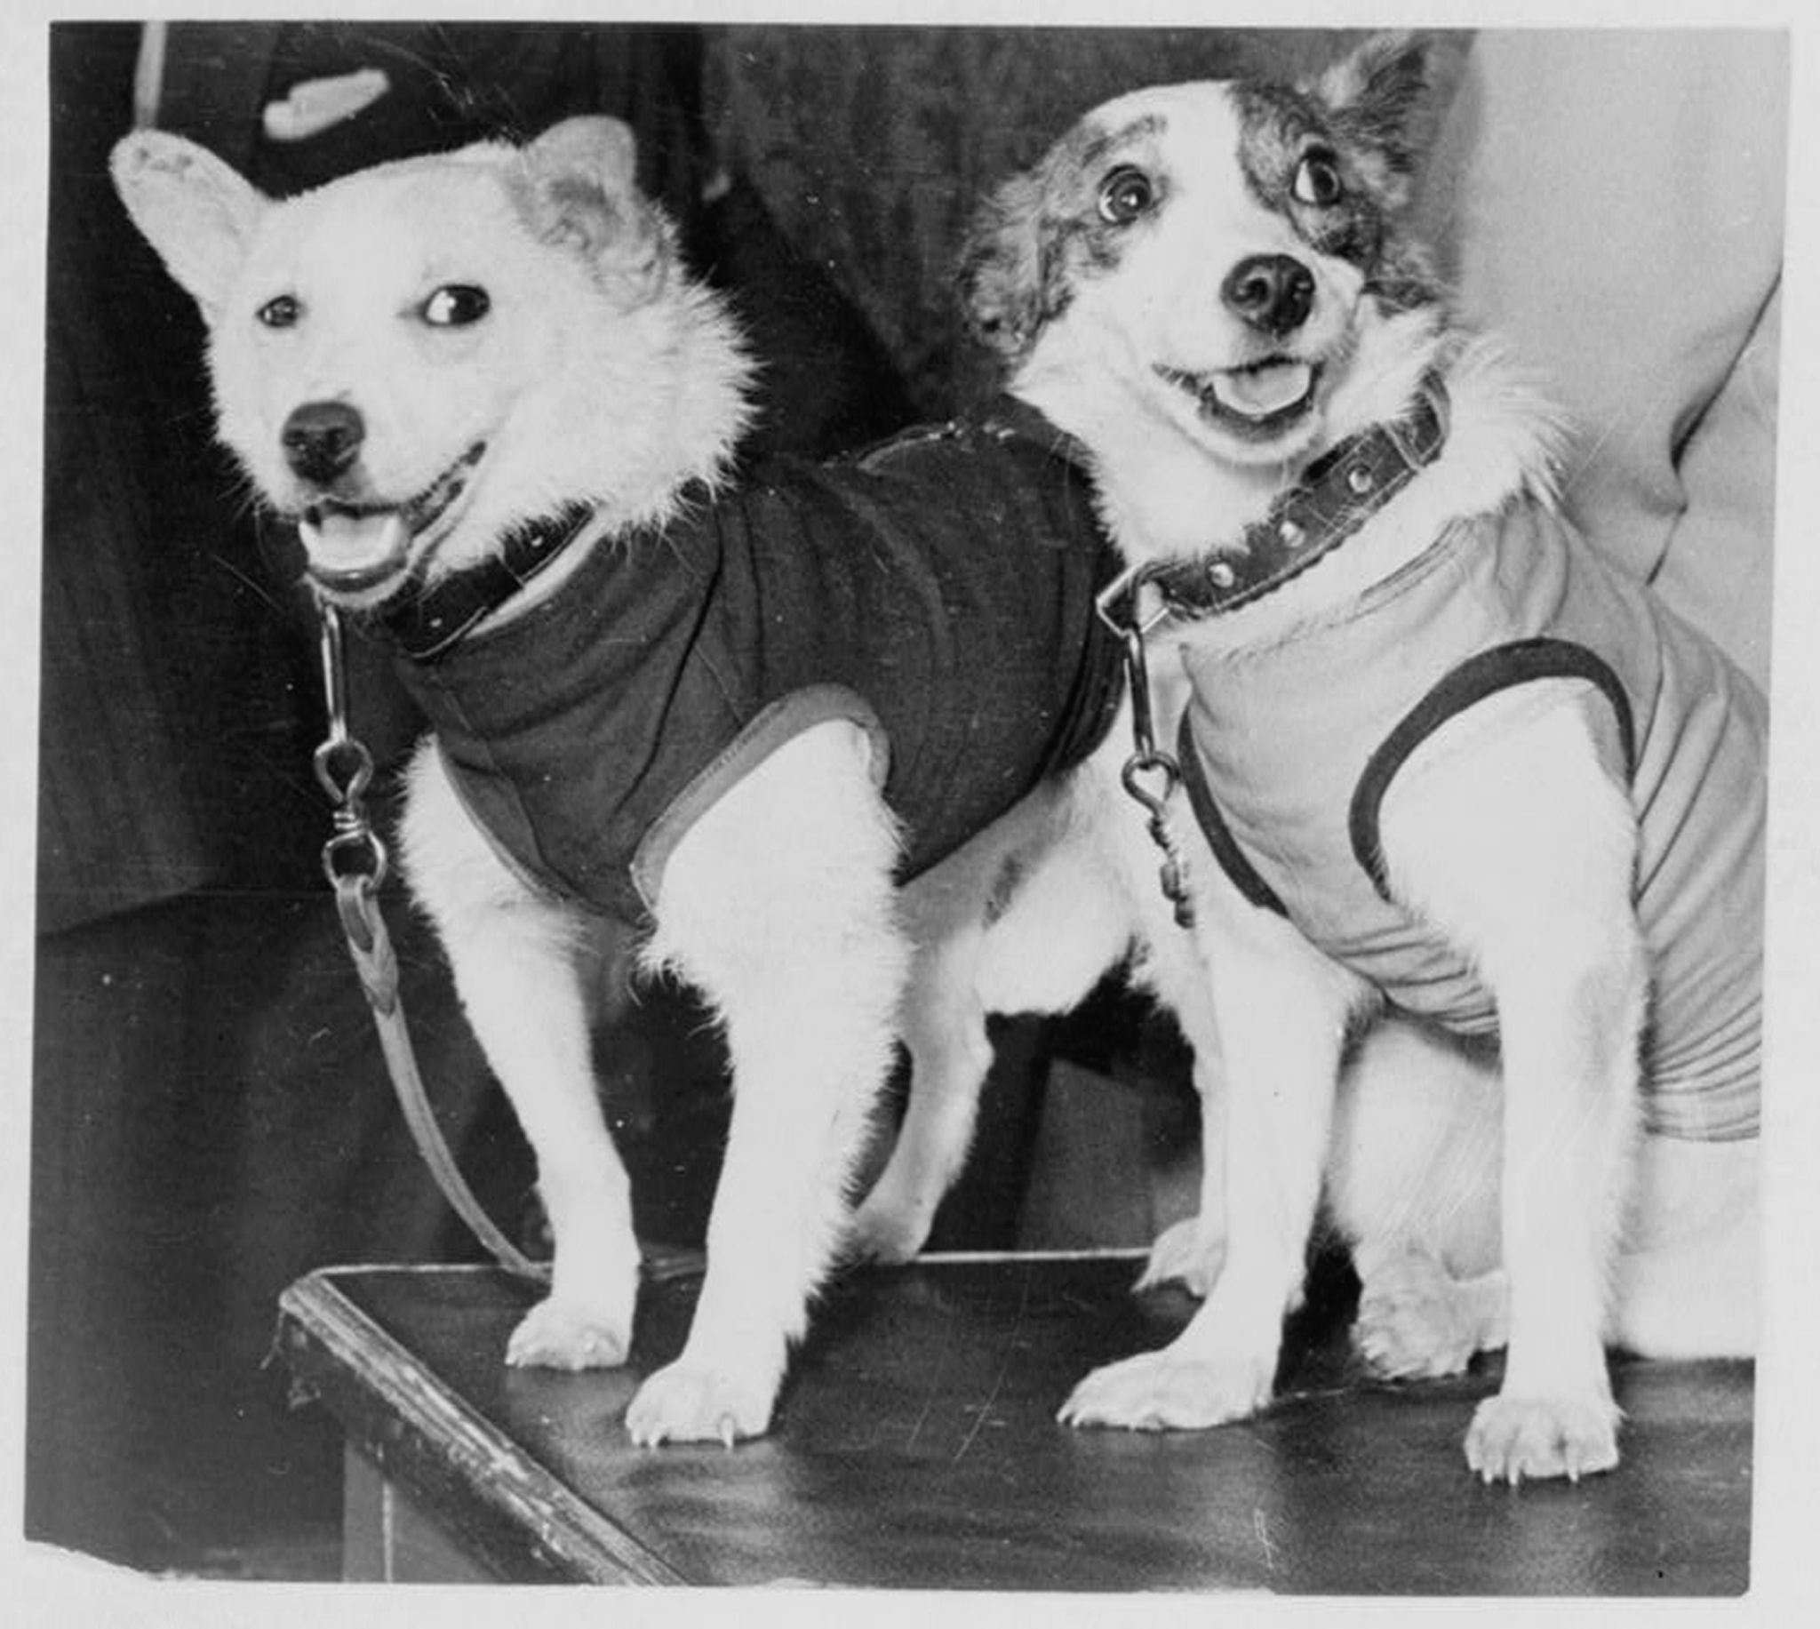
Animals in Space
Before humans dared to explore space, animals pioneered survival in orbit. From small insects like fruit flies to bigger creatures such as dogs, cats, and monkeys, these creatures were launched into the sky against their will for the betterment of human technological advances.

Slide 15
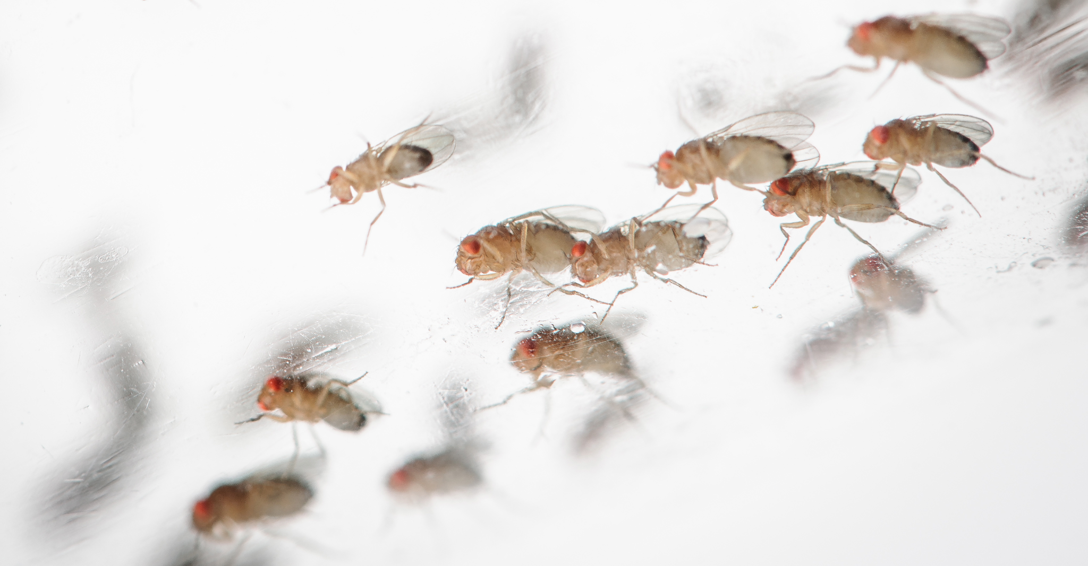
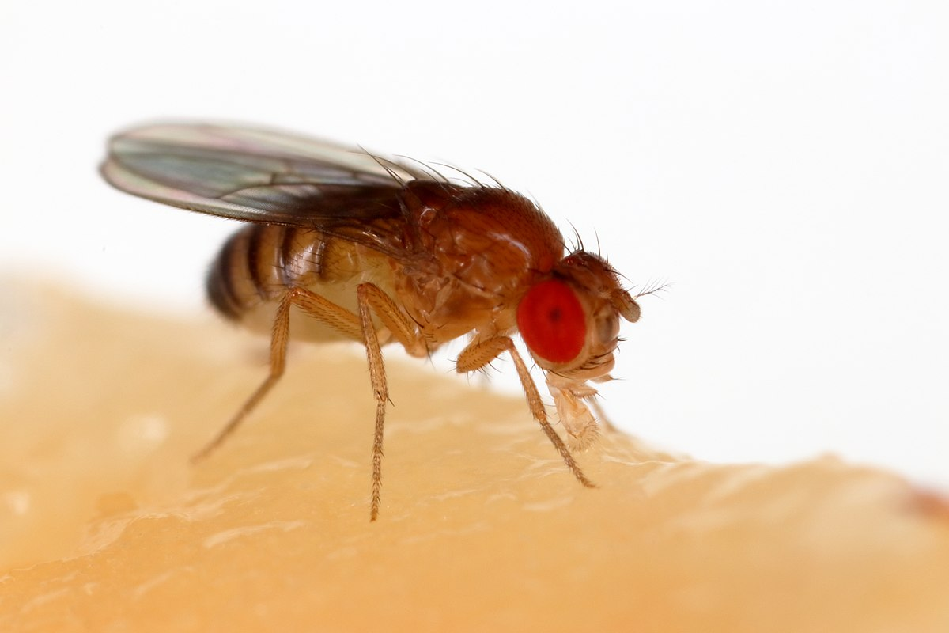


Fruit flies were the first animals to be sent to space in 1947. This was done in order to test radiation.
And they came back alive!!
A year later, scientists to decided to jump from insects to animals (what could possibly go wrong!!!). The first monkey that was sent to space was called Albert.

Slide 16
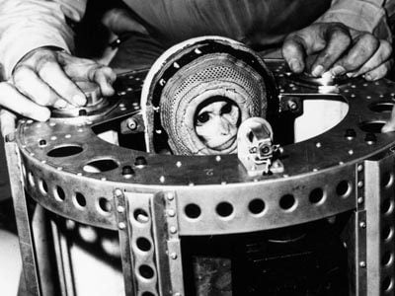

Albert died from suffocation before he could reach space.
A year after Albert died, they decided to try again, this time calling the monkey Albert II. This Albert made it to space and managed to stay alive.
However, Albert II’s parachute failed to deploy, killing him on the descent to Earth.

Slide 17


Albert V
Parachute also go bye bye
Albert III
Literally exploded
Albert IV
Parachute go bye bye

Slide 18
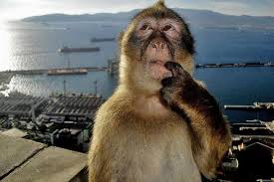
Finally in 1951, they had finally figured out how to make a parachute that didn’t liquify the monkeys on impact. Consequently, Albert VI’s life was spared and so was his 11 mouse housemates. However, he died 2 hours later due to his seal overheating while waiting for recovery.

Slide 19
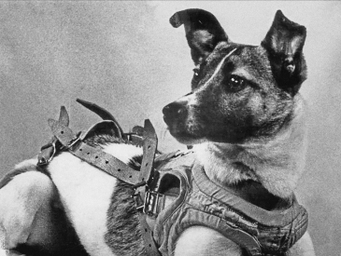
Scientists didn’t stop there, one of the more famous animals to be sent to space was a dog named Laika who wasn’t expected to return. Before the mission, she would be put under the most intense form of training. They would put her in a centrifuge to get her used to G-force, progressively make her cage smaller- this would make her stop urinating or defecating and made her eat a high nutrition gel.
Due to the involuntary help from (and many more of) these animals, humanity couldn’t have made it to space.

Slide 20
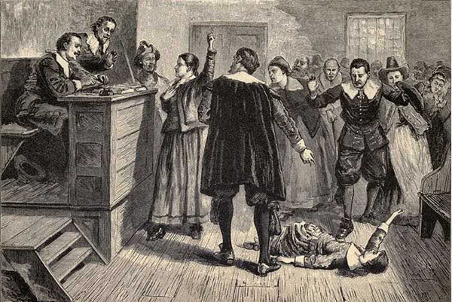
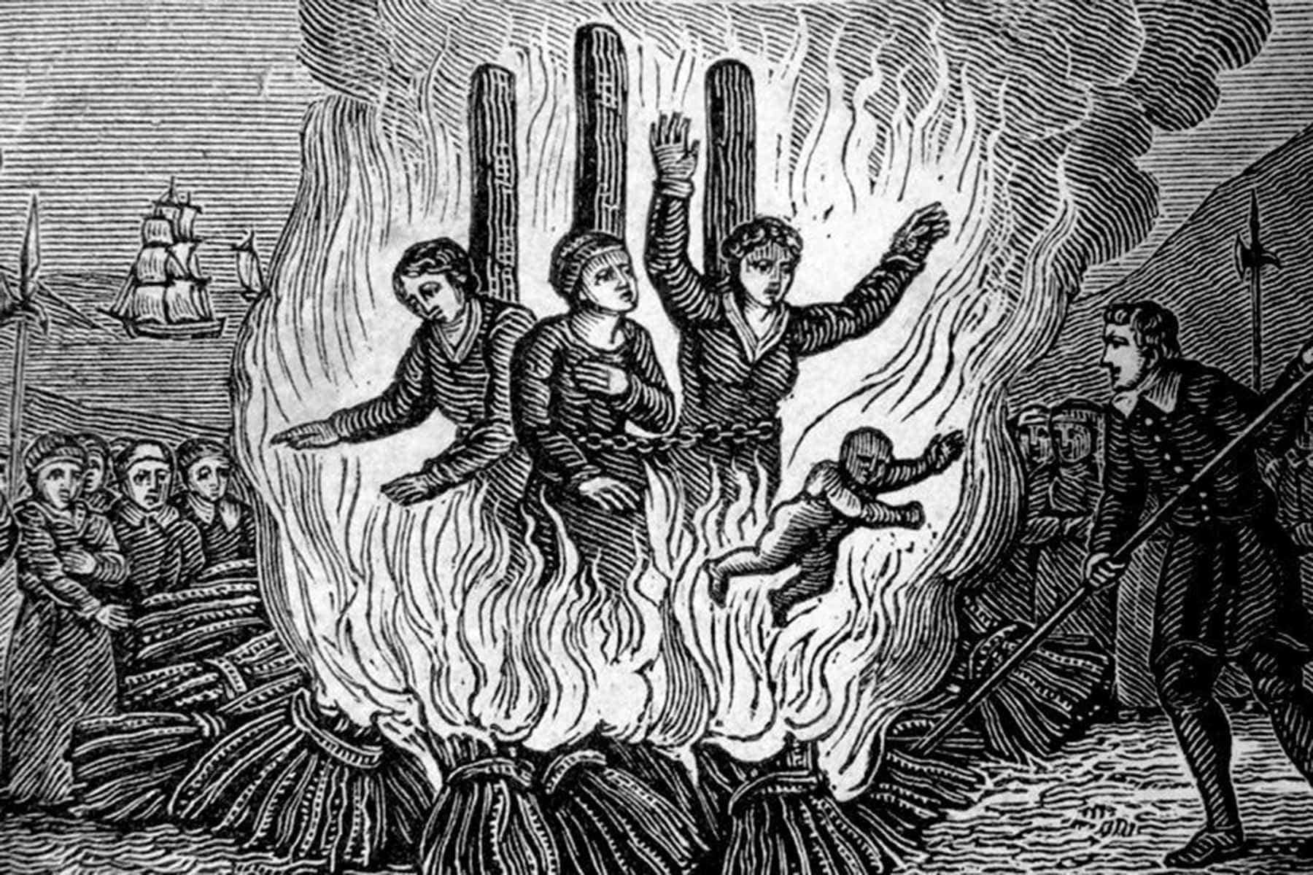
Salem Witch Trials
In February 1692 - May 1693, the village of Salem, Massachusetts, became the site of the Salem witch trials which was one of the most infamous periods of history for its hysteria and injustice.
The winter of 1692 was the coldest on record, which added onto the paranoia. That winter, two cousins, 11 year old Betty Paris and 9 year old Abigail Williams, started to exhibit strange behaviours. A physician didn’t find anything wrong, but diagnosed them as “under an evil hand”

Slide 21
4 of 12 girls afflicted accused 3 of the local women of tormenting them. These women were outsiders in some way:
Sarah Good - A poor pregnant mother with a daughter
Sarah Osbourne - Absent from church for a while
Tituba - Enslaved women from Betty Paris’ residence.
Although Tituba denied harming the girls, she then confessed to practicing witchcraft under the devil's hand. Sarah Osbourne died in prison and Sarah Good was turned away from her husband and daughter. She then gave birth in prison but the child died. Shortly after, she was hanged. (Brian A. Pavlac, 2020)

Slide 22
What were the signs of being a witch?

Slide 23
1. You are a woman
2. You cannot support yourself financially
3. You are rich or financially dependant
4. You have one or more woman friends
5. You’ve had an argument with your friends
6. You’ve disagreed with someone
7. You are very old
8. You are very young
(beckmann, 2015)

Slide 24

Thanks thats all yay

