Slide 1
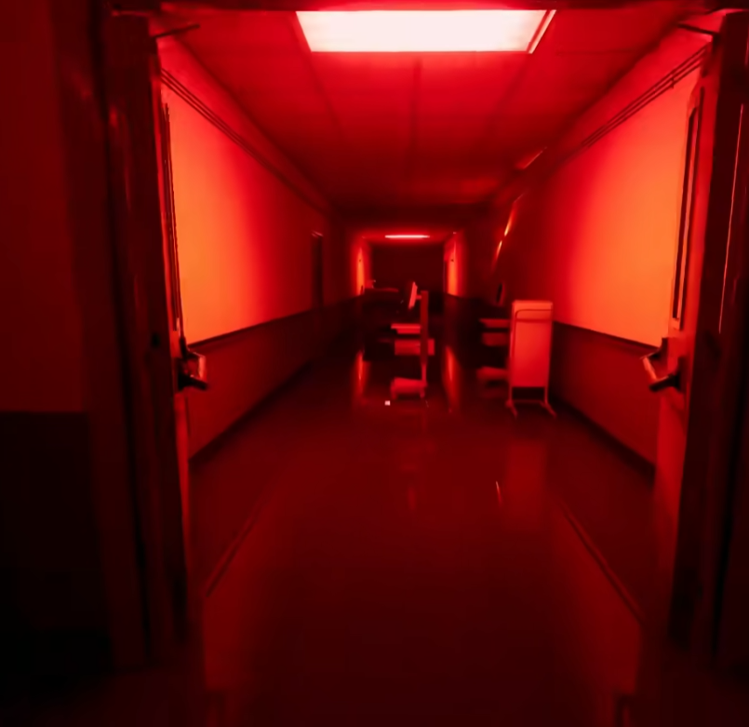
《Chase – The Fading Warmth》
Essential Experience：
I want players to feel how warmth and safety gradually fade into fear when ignored —
an emotional chase where the enemy is not a creature, but the loss of tenderness.
Design Intention：
The game creates the gaming experience through three pillars: "environment", "sound feedback", and "fear of the unknown".

Slide 2
Pillars1：Environmental pressure
The environment itself can bring pressure. By exerting mental stress on people within the environment through "lighting" or "Space".
Lighting: By using the gradient of light, let the warm light gradually become cold and dark, which will create a progressive psychological pressure
Space: Narrow corridors and restricted views bring a sense of oppression
The environment itself changes emotionally.
Lighting, color, and space gradually shift from warmth to oppression, making the player feel loss before realizing it.

Slide 3
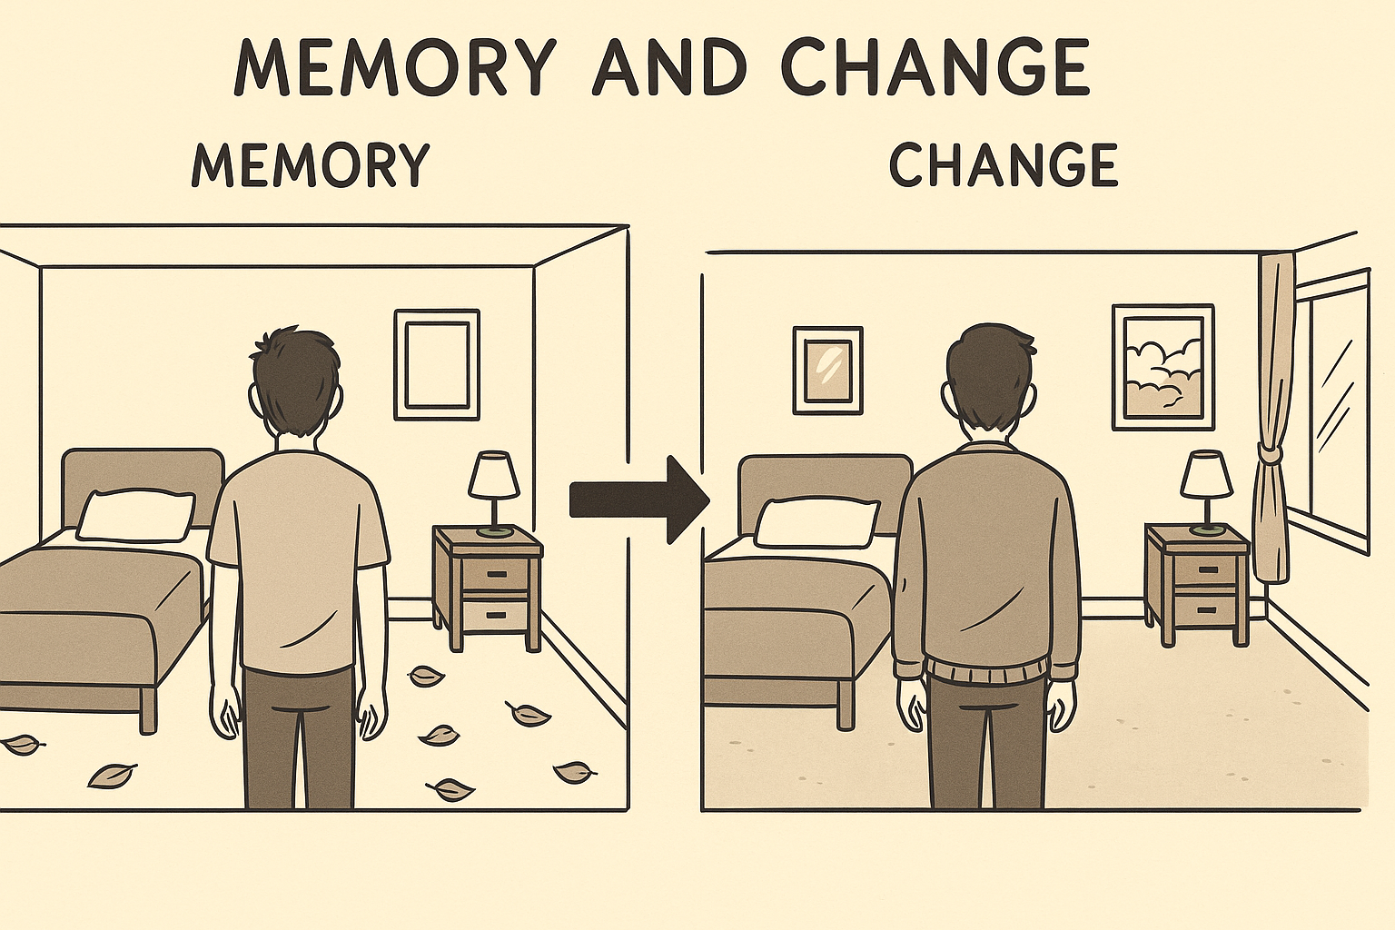
Pillars 2：Different cycles
Each cycle is roughly the same, but there will be some changes in some details
Each time a player makes a different choice, it will lead to different changes in the scene. It can be gaining or losing something, and all these changes contain information.
Sound is a fragment of memory, each carrying a story

Slide 4

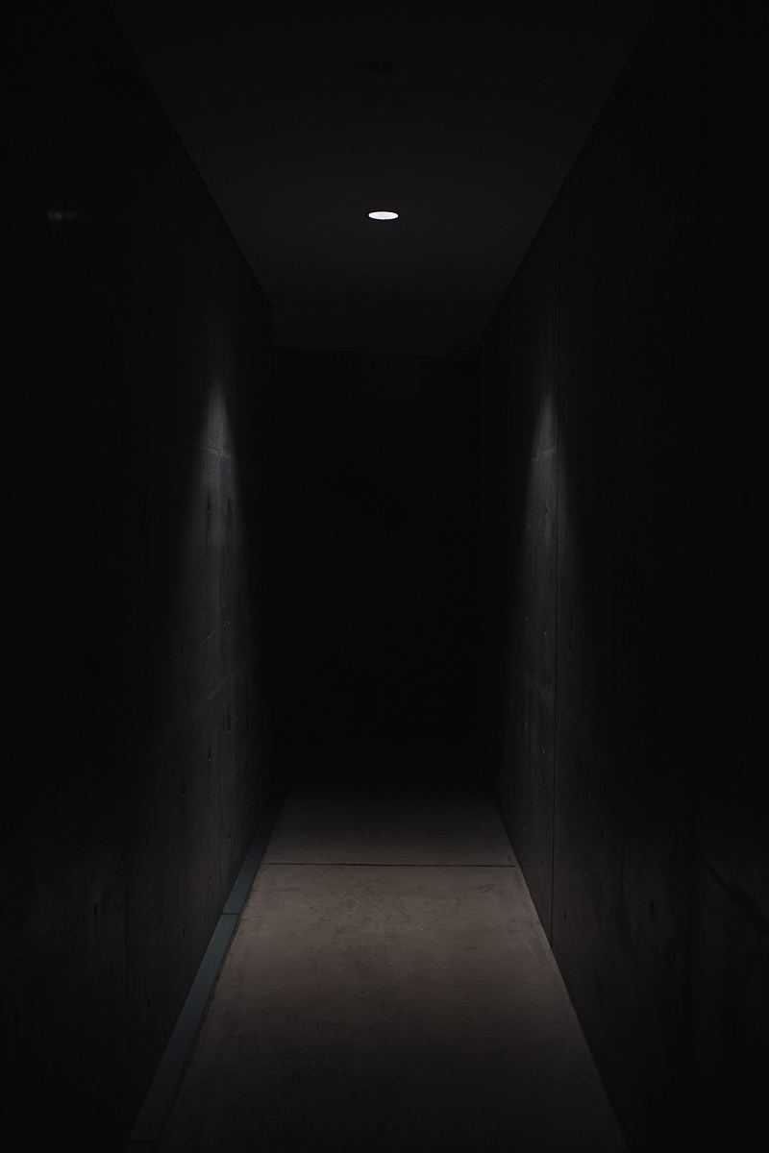
Pillars 3：fear of the unknown
What is terrifying is not what you see, but what you cannot see.
Spatial contrast:
The same corridor, once filled with warmth and human warmth, now only leaves emptiness and coldness. This change and contrast will prompt players to think
Psychological silence: When warmth, sound, and presence fade,
the emptiness itself becomes unsettling.
Even if players do not see any threats, they can still feel nervous.

Slide 5
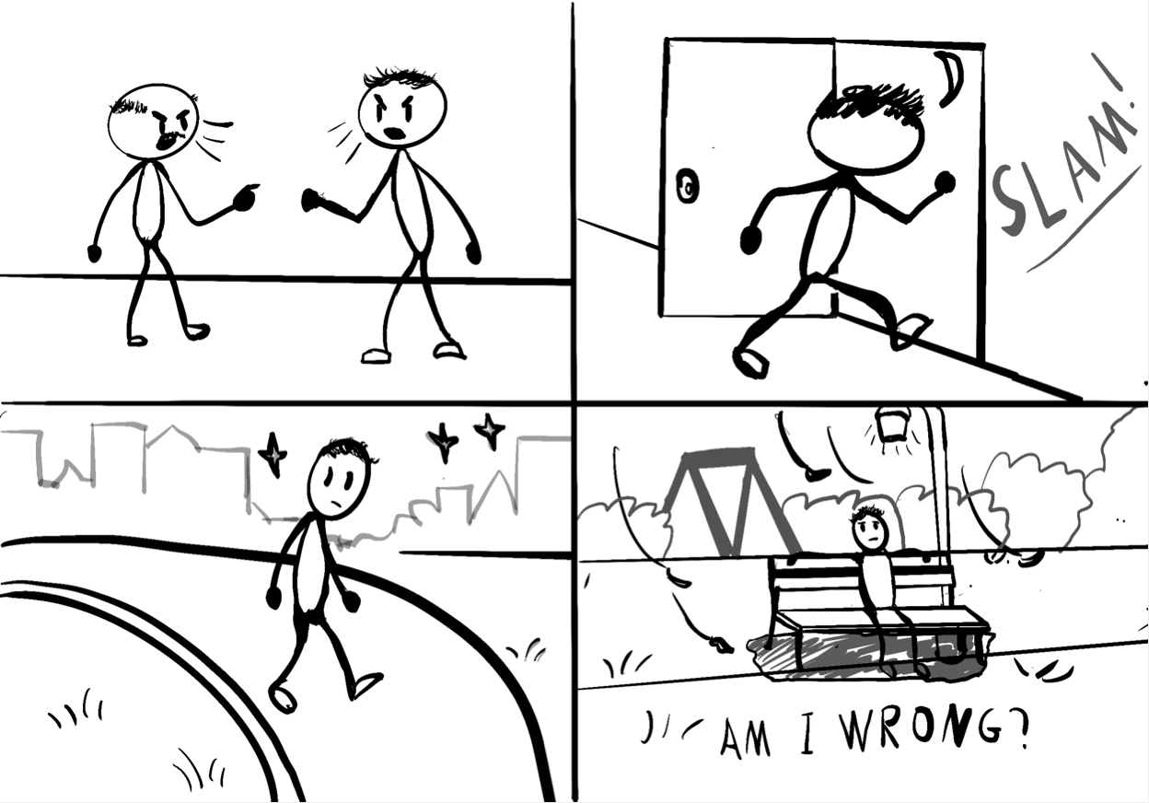
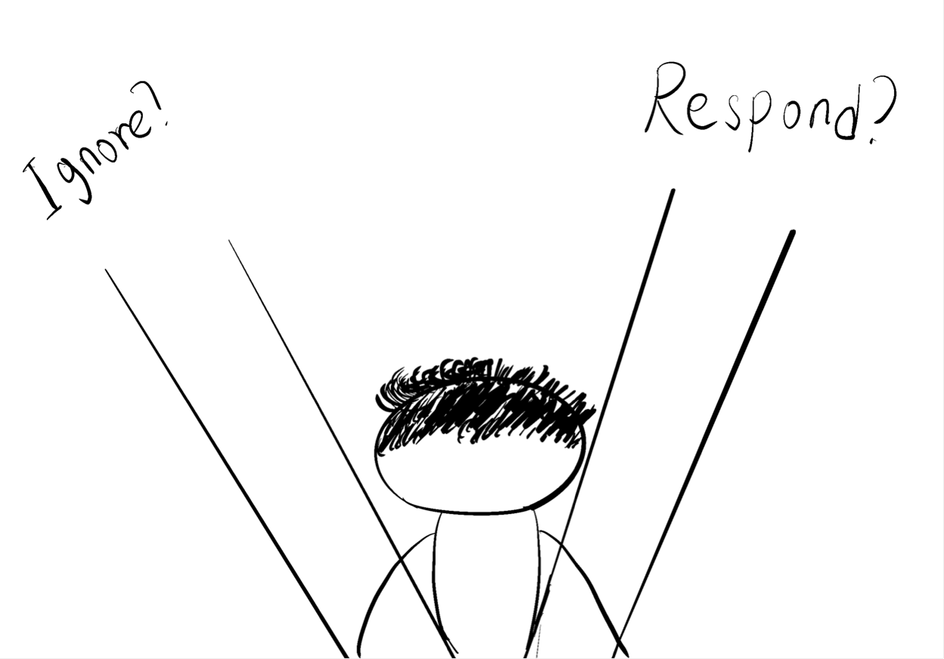
The game loop is different from the traditional "kill monsters and level up". Instead, it involves choices. Players start from the beginning, walk a certain distance, experience some events, see a scene and hear some sounds, and then face some choices. After that, they return to the starting point. The difference is that the scenes and sounds will change according to the player's choices, and eventually reach the ending.

