Slide 1

“The Balance of the Heart is a narrative game where every choice quietly tips an invisible Karma scale, and the world changes to reflect who you’re becoming.”

Slide 2
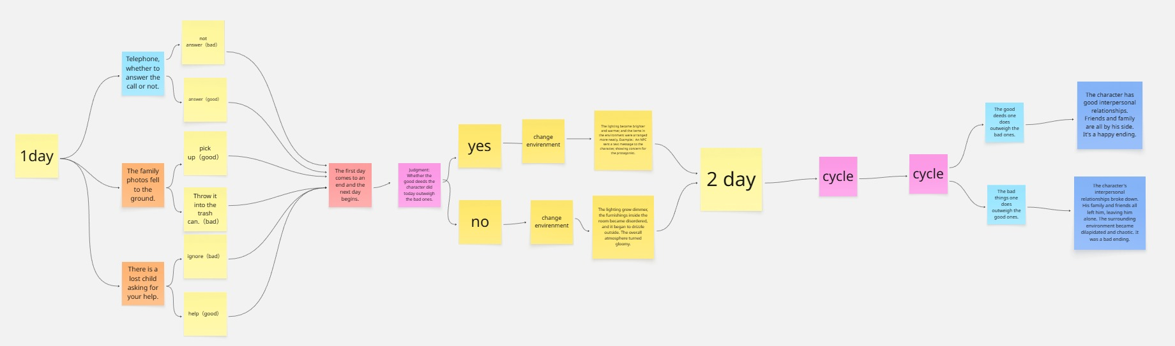
Objective: Reach an ending that truly reflects your values.
How: Explore familiar spaces for seven days, make value-driven choices, and read the next day’s environmental changes—light, colour, weather, and people—to infer how the invisible karma scale is tipping.
Explore → Choose → Invisible Scale (good/evil weights) → Next-day World Reaction → Repeat → Day-7 Judgment

Slide 3
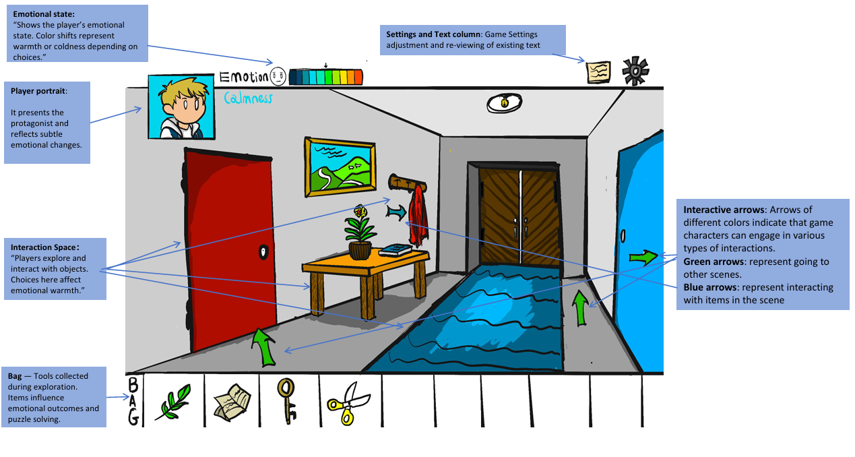

Slide 4

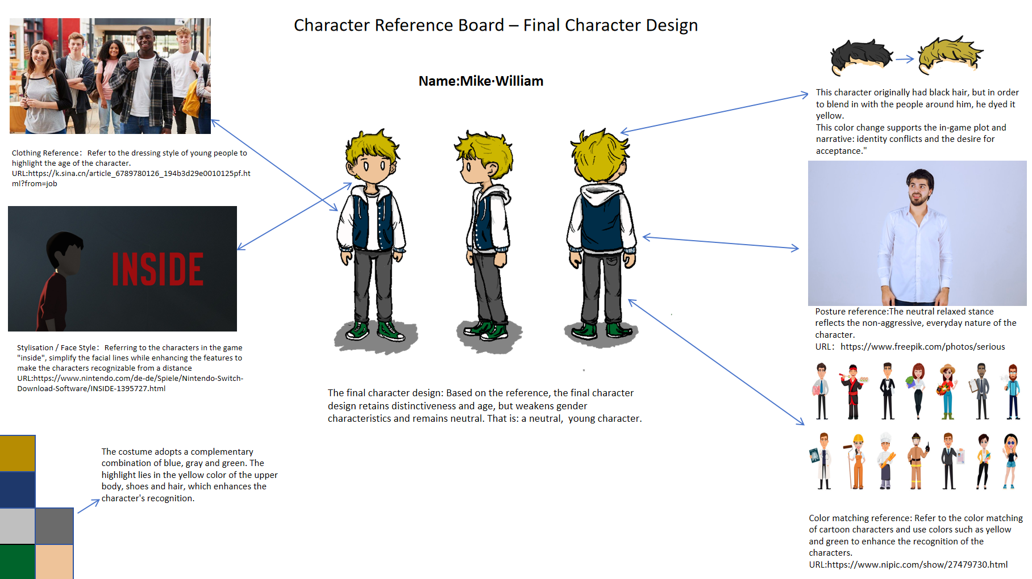
character
The main character of the game
NPC: A character that cannot be controlled by the player and is used to advance the game's plot.
There are characters available for players to control. Players will control this character to explore the scene or interact with other NPCS.

Slide 5
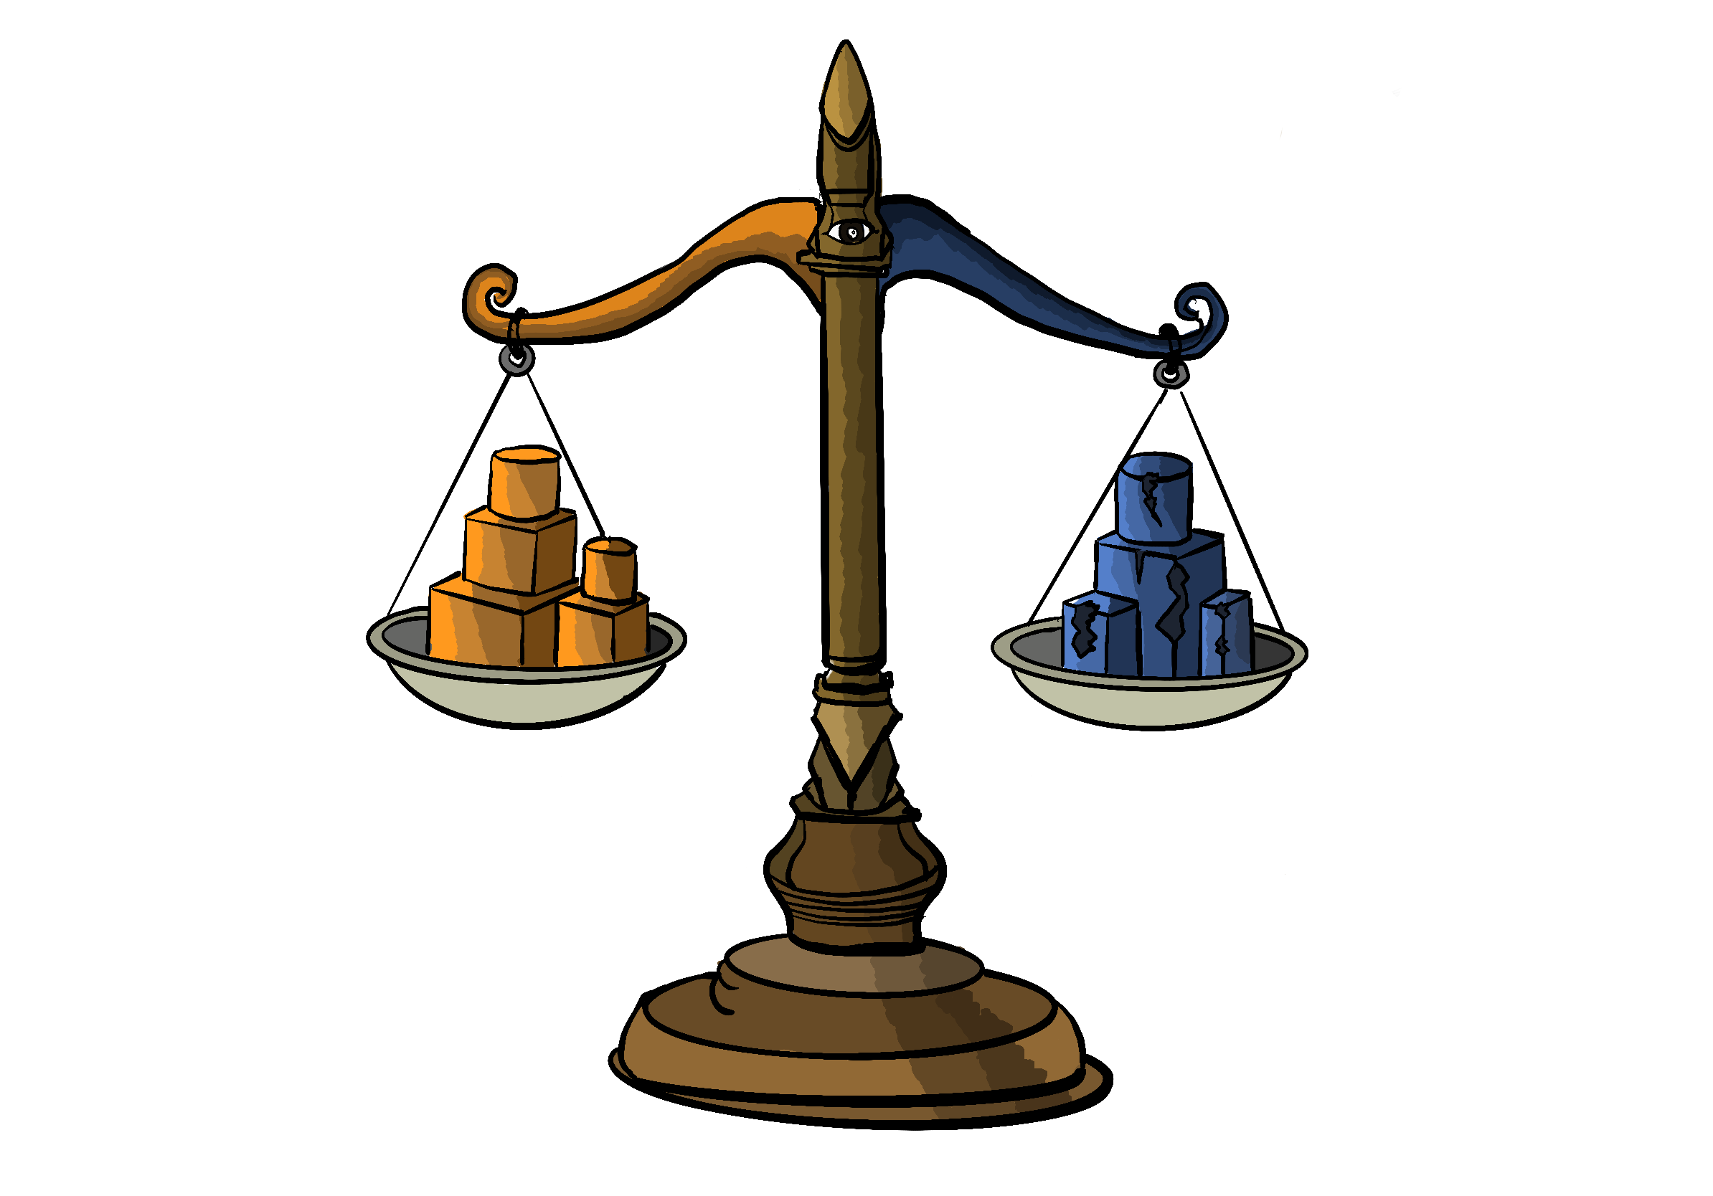
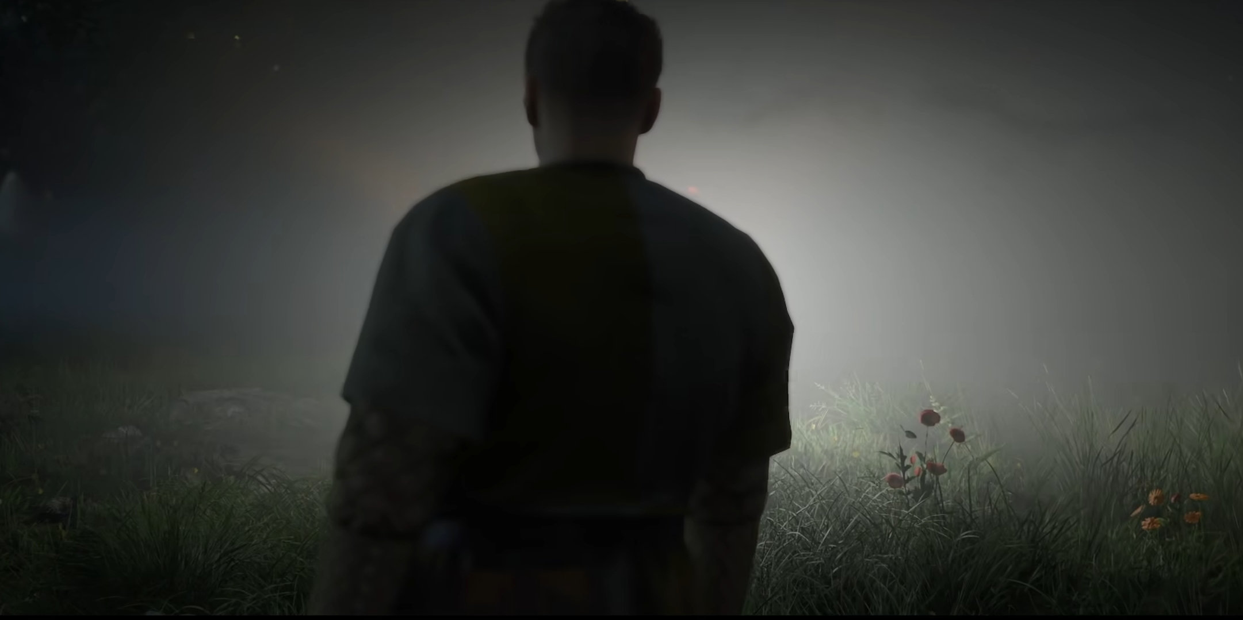



Game Backgroud：
After a car accident, a boy pleads before a God that he is a good person. He is sent back for seven days with an karma scale—every choice drops a good or evil weight. The world quietly reacts each new day, and on the seventh, his fate is judged by what the scale reveals.
Game core：
The core of my game is an invisible scale of good and evil. This idea I got from similar systems in Kingdom come Deliverance 2 and Red Dead Redemption 2. Every action a player takes will affect their karma value. Players won't see the level of their karma value but can get the answer from the people around their characters.
End：Pass the test and return to the world
Good karma
Karma scale：A scale that measures karma is invisible to the player in the game. It only changes the environment around the player as the center of gravity of karma tilts.
Too low karma
The ending of hell

