Slide 1

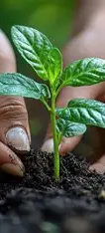
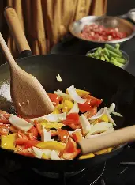
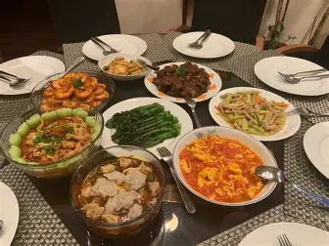
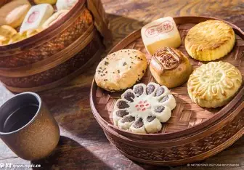
Four Topics –
Planting, Cooking, Chinese Food, Dessert
-Yushan Yao

Slide 2
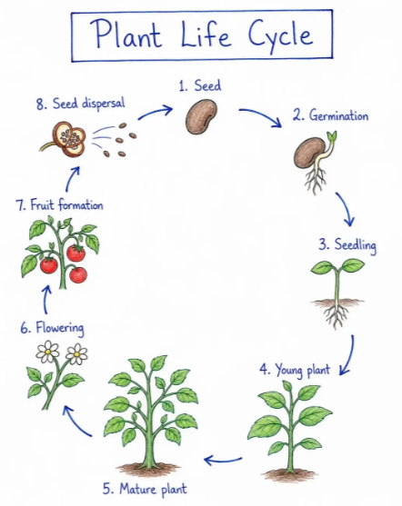
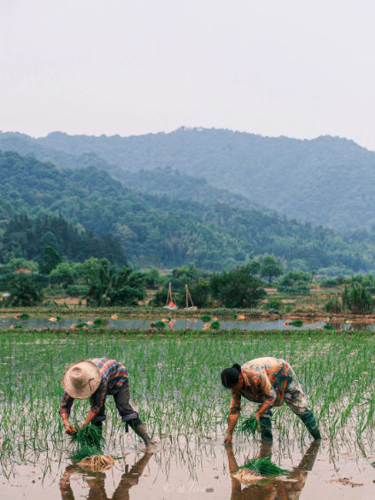
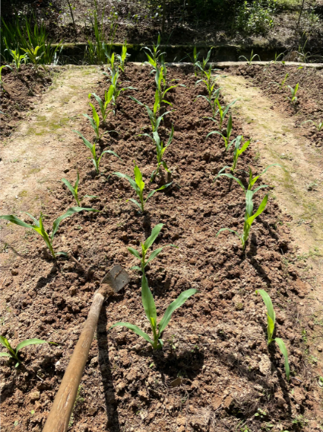
Topic 1 - Planting
How does a plant grow?
What is Planting?
Seed → Germination → Seedling → Growth → Flower → Fruit
The activity of putting plants into the ground or into container of soil so that they grow, or the activity of designing how they are arranged.
- Cambridge Dictionary

Slide 3
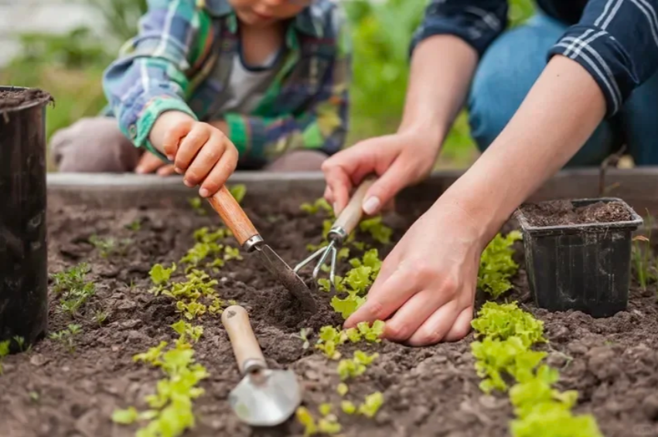
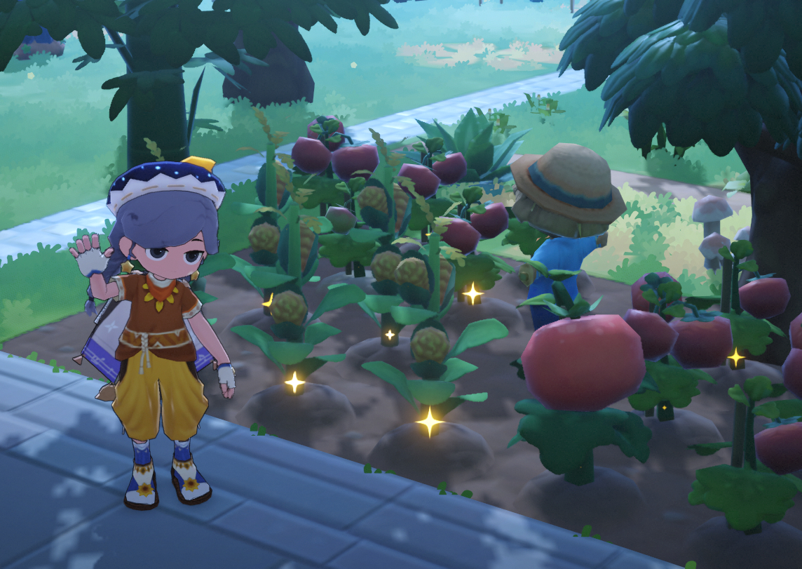
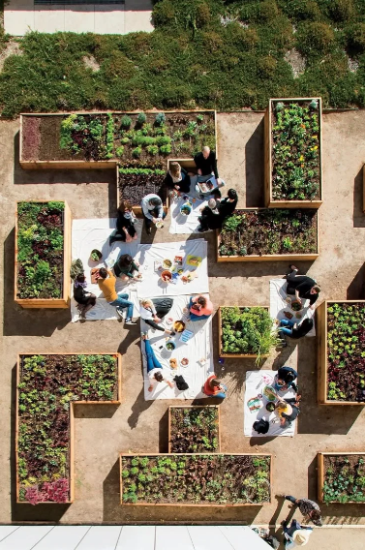
Why do people enjoy gardening and planting?
People enjoy gardening or plating, because it helps relieve stress, provides achievement, helps find sensory pleasure and has a social aspect (Min, M. , 2026).
Achievement： People can sense a living being’s dependence on them and its growth. This visible progress is one of the main driving forces behind enjoying life.
Sensory pleasure： Engaging directly with nature can significantly improve mental and physical health, and planting or gardening is one of the most direct ways to do it.
Reference： Min, M. (2026). Why Do People Enjoy Gardening? | More Than Just Digging Dirt. [online] Lawn Gear Lab. Available at: https://lawngearlab.com/why-do-people-enjoy-gardening/ [Accessed 2 Oct. 2026].

Slide 4
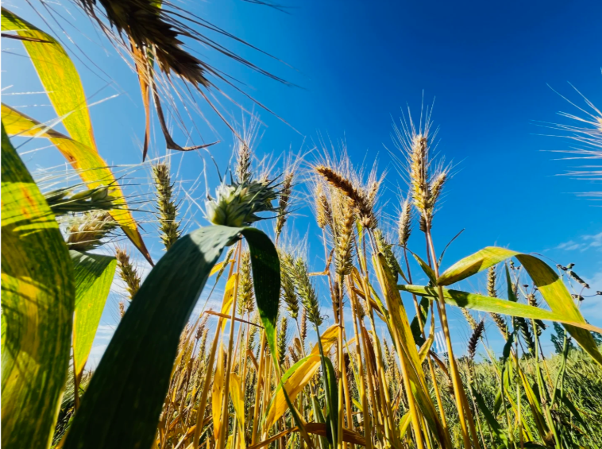
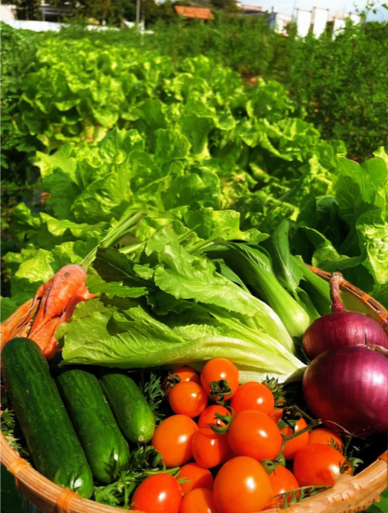
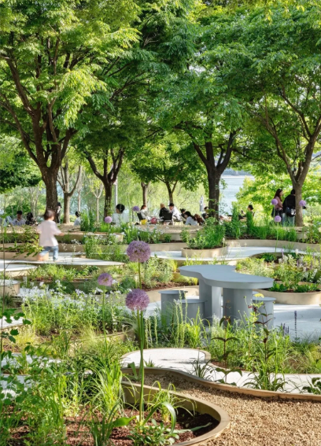
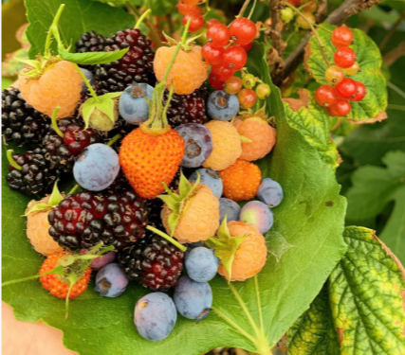
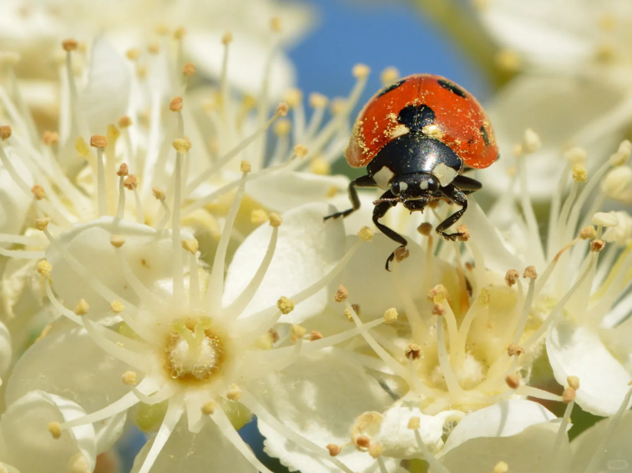
Why is planting important for the environment?
Urban gardening
Purify the air
Food production
Biodiversity
Notes:
First, Plants can purify the air, reducing the amount of pollutants in it.
Secondly, People can get food from plants. For example: vegetables, fruit and cereals. This is the main reason why people relies on planting.
Thirdly, Planting helps to protect biodiversity and maintain the balance of species in nature.
Last, Planting can enhance the living environment in urban cities.

Slide 5
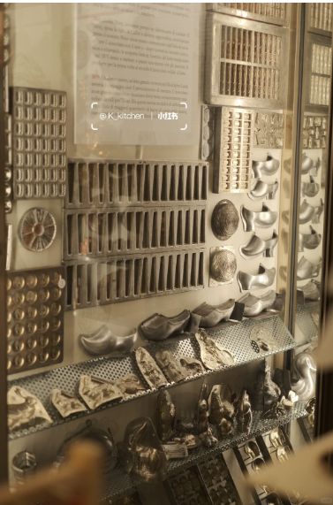
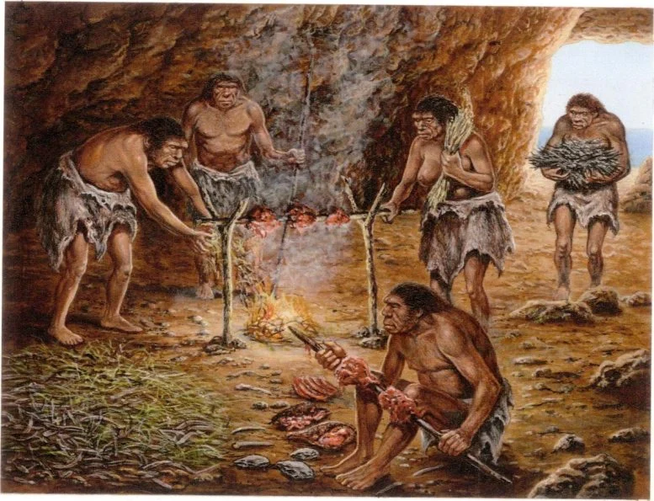
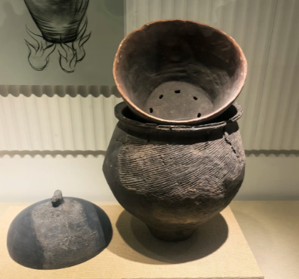
Topic 2 - Cooking
What is cook
When you cook food, you prepare it to be eaten by heating it in a particular way, and when food cooks, it is heated util it is ready to eat. – Cambridge Dictionary
History of cooking:
1.8 million BCE: Human find fire and to cook food. It is for killing bacteria.
7000 BCE: First time humans used cooking equipment to cook food.
100 CE: Romans develop advanced cooking equipment.
700 CE: Arab culture developed sophisticated cooking techniques.
Cooking has evolved from a means of survival into a way of life.
Reference:Classicfork.com. (2025). Cooking History Timeline – Classic Fork. [online] Available at: https://classicfork.com/cooking-history-timeline/ [Accessed 2 Oct. 2026].

Slide 6
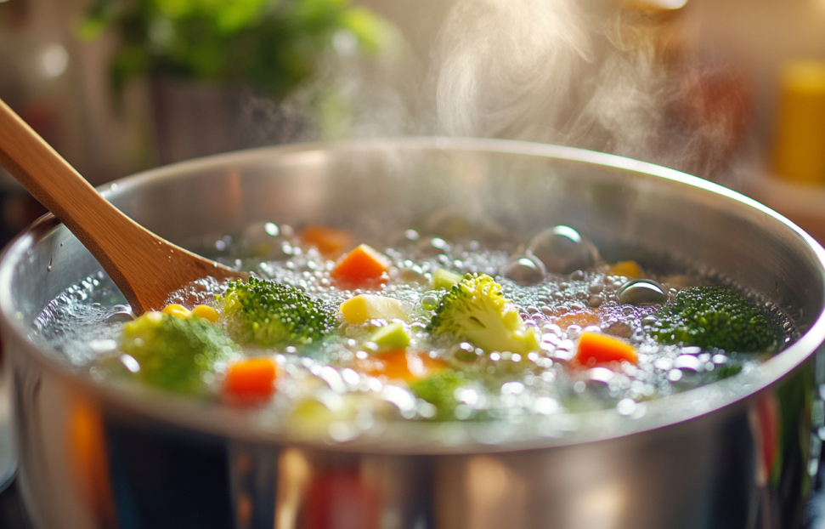
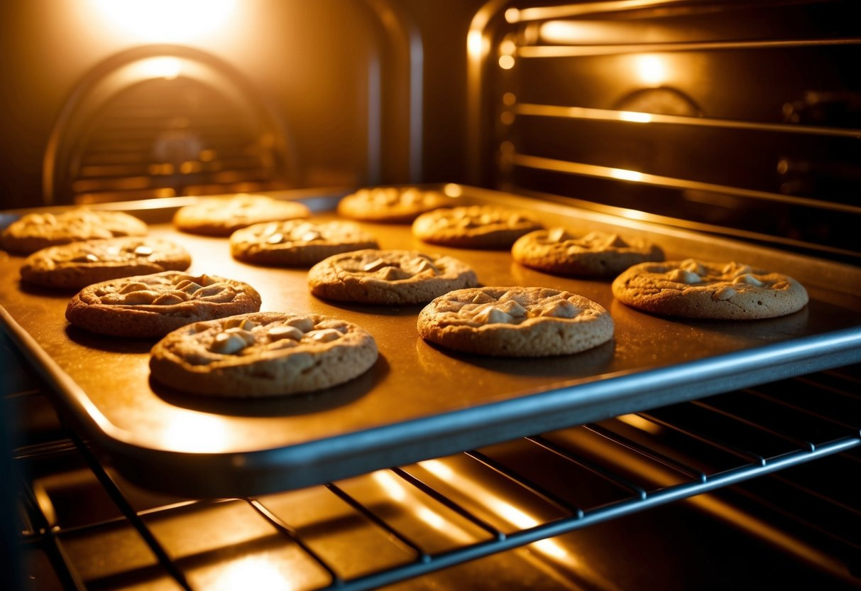
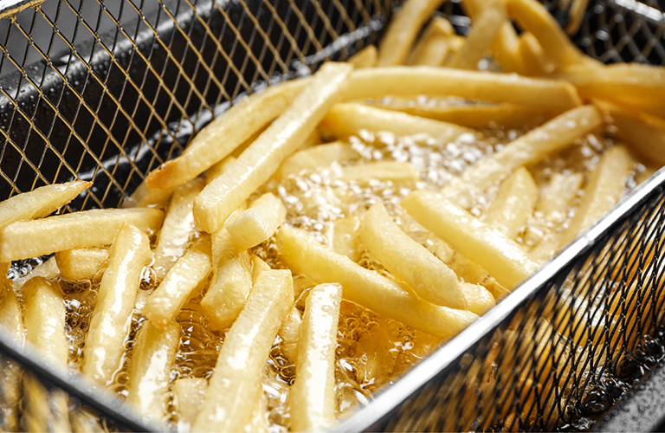
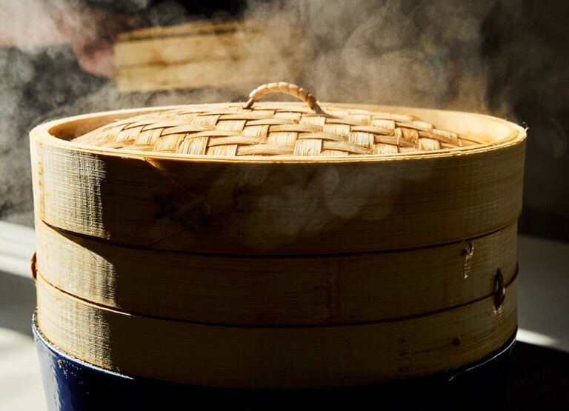
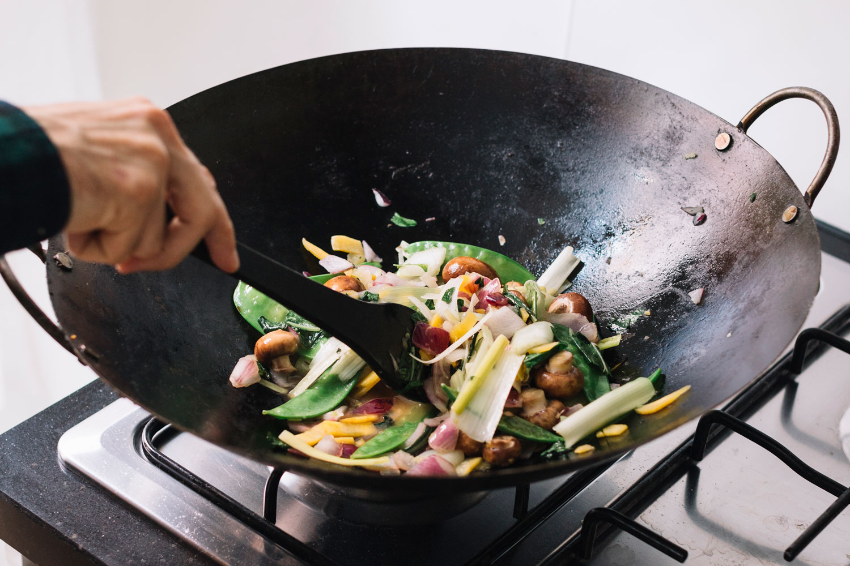
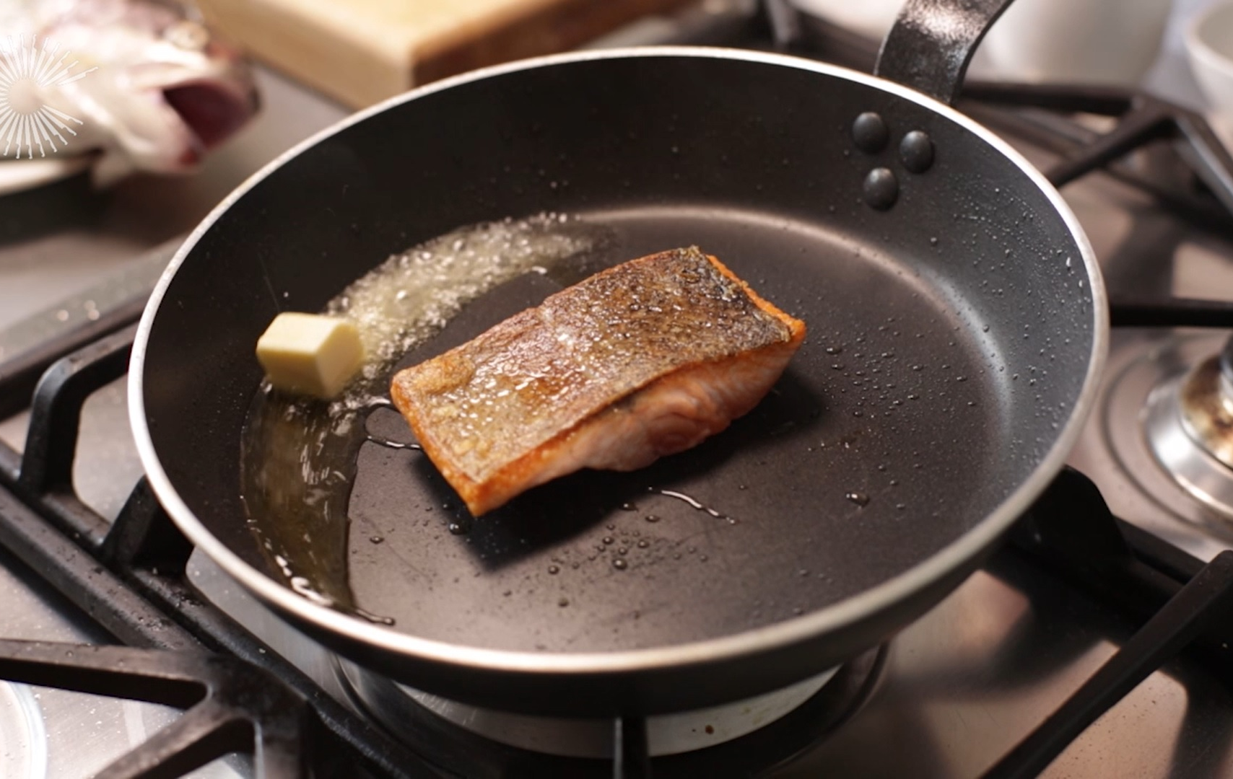
Cooking methods:
Boiling
Baking
Deep-frying
Steaming
Stir-frying
Pan-frying

Slide 7
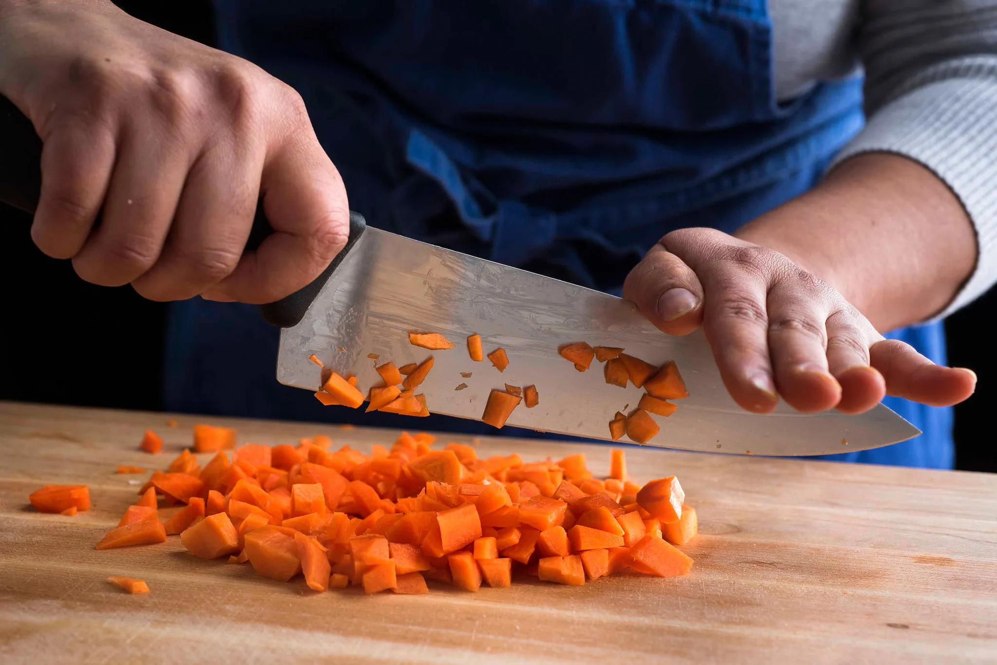
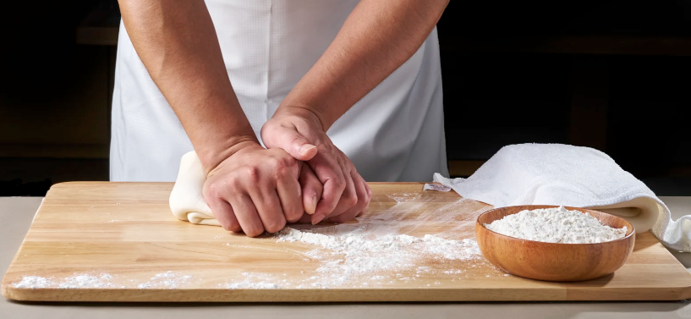
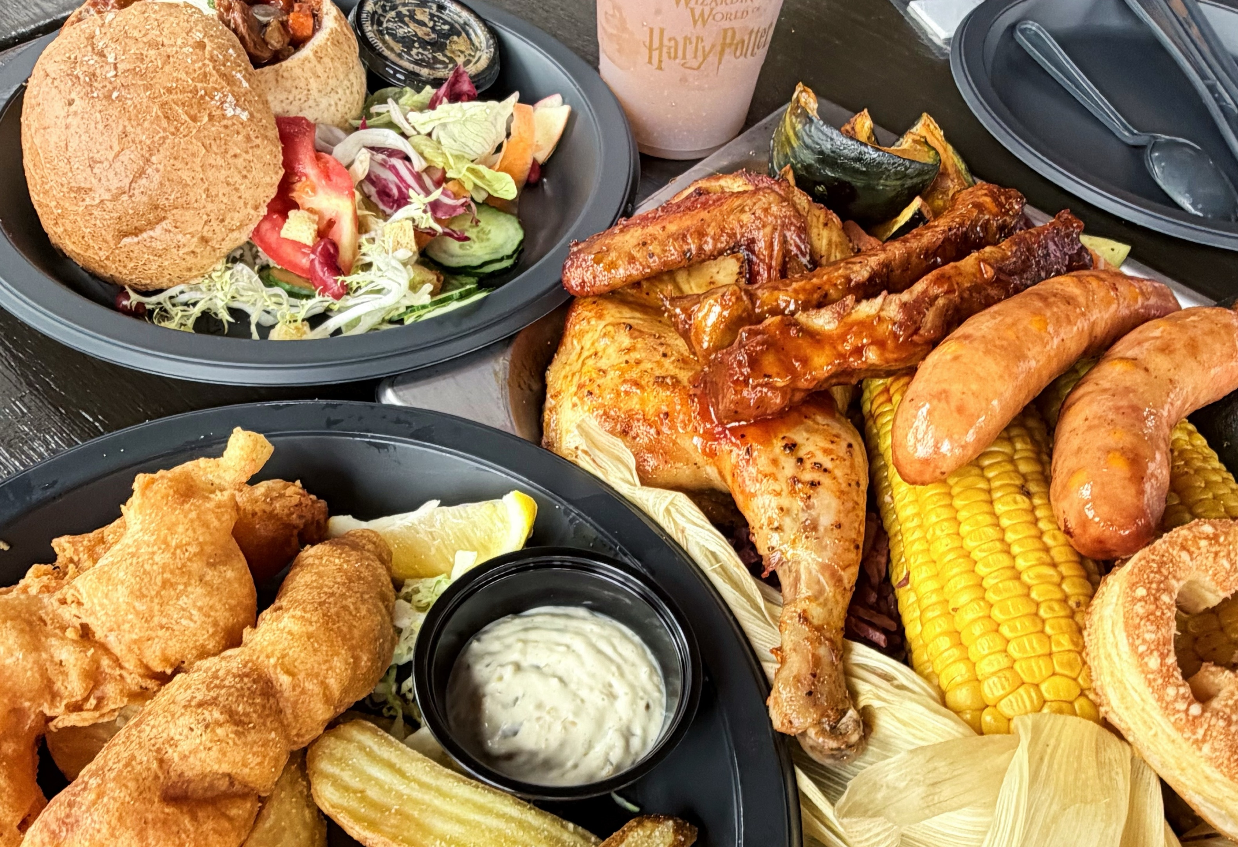
Why do people enjoy cooking?
Because cooking is an extremely rewarding activity. It is a form of creative expression and a way to relieve stress.
Hearing: The sound of a knife cutting food, the sizzle of hot oil and the bubbling of the sauce combine to create a melody.
Smelling: The aroma given off by food as it cooks can evoke happy memories.
Visual: The colours of fresh vegetables and the deep brown of the meat. The combination of colours is like a painting.
Touching: People can perceive the texture and temperature of different foods.
Reference:Silas (2026). The Real Reasons We Love Cooking: More Than Just Food. [online] Flavor365. Available at: https://eathealthy365.com/the-real-reasons-we-love-cooking-more-than-just-food/ [Accessed 3 Oct. 2026].

Slide 8
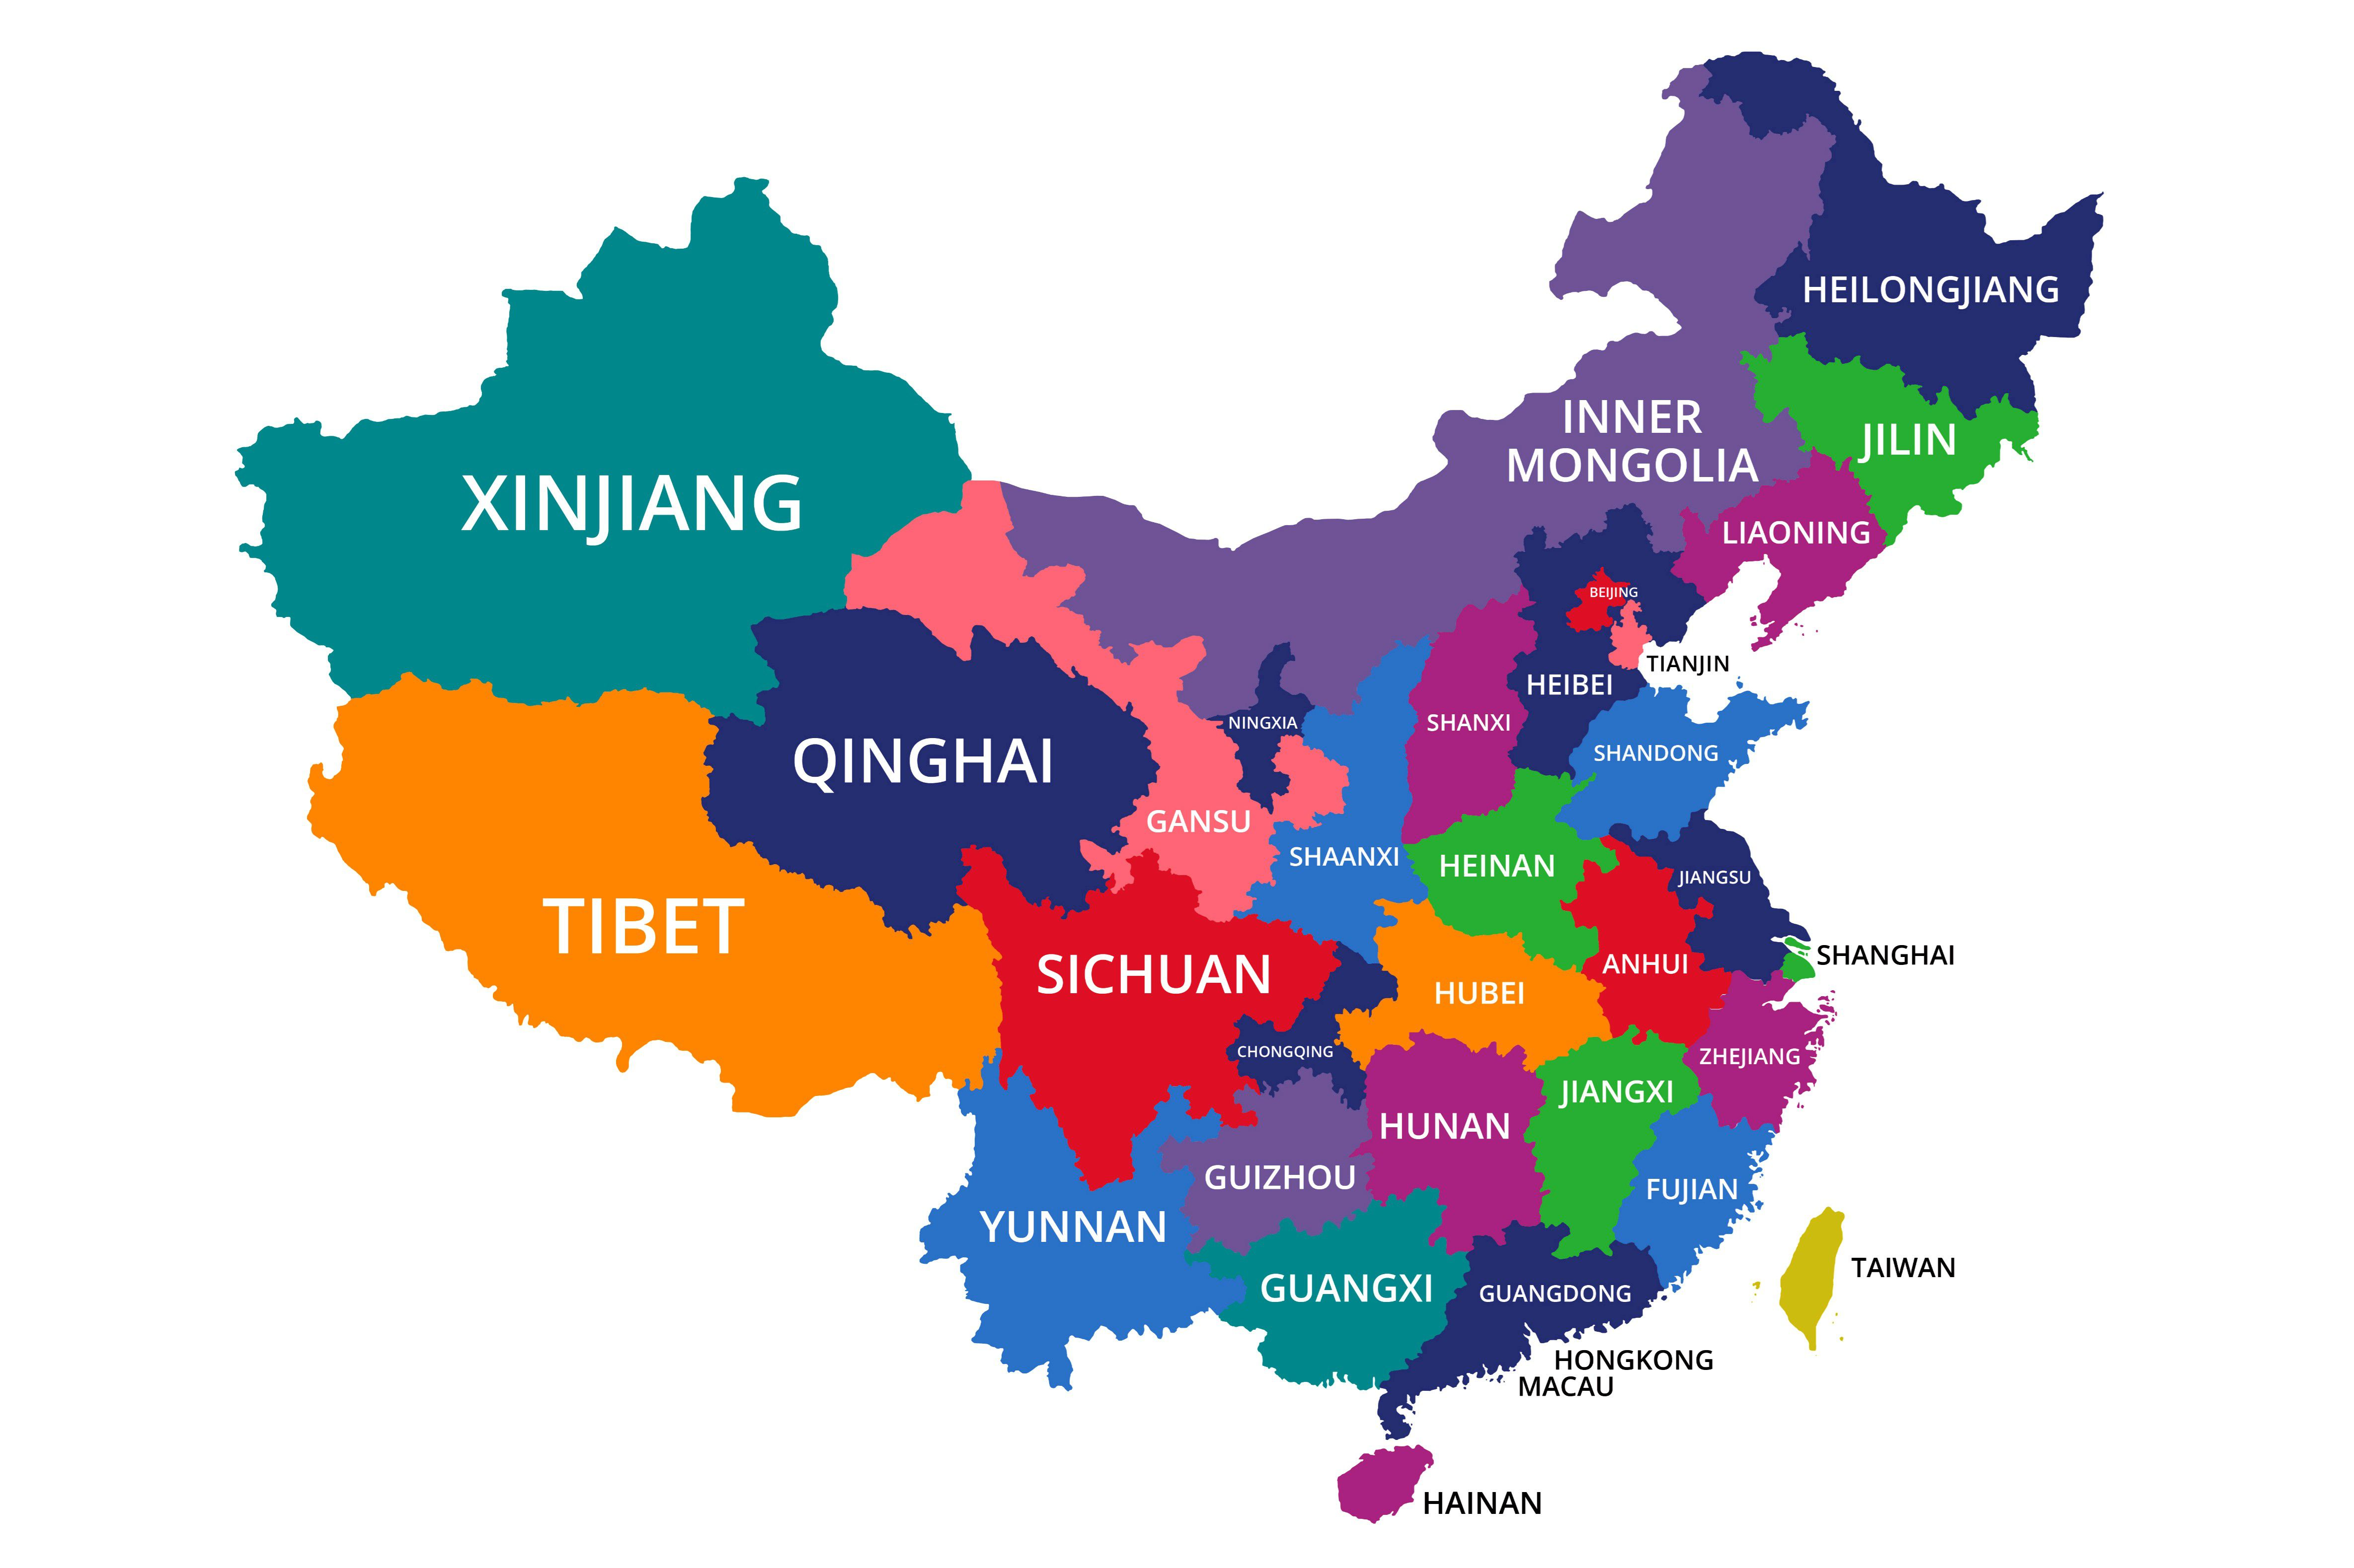
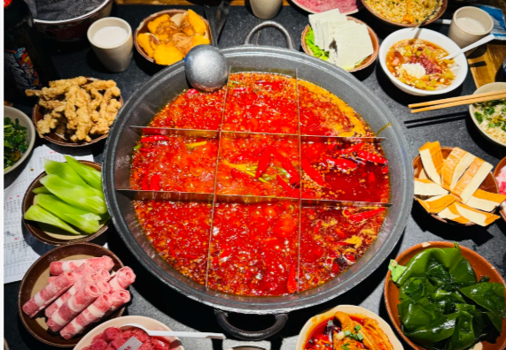
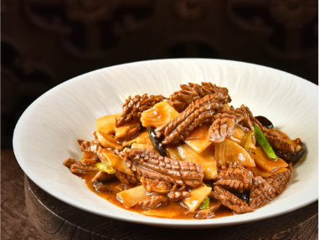
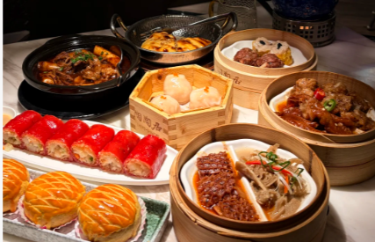
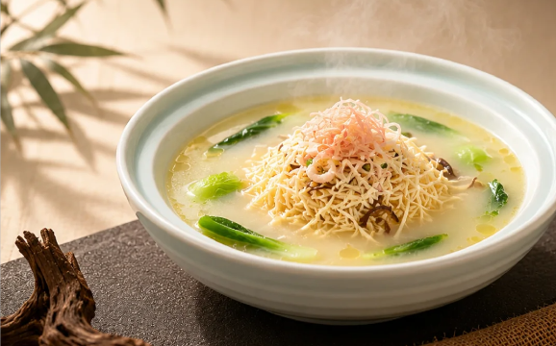
Topic 3 – Chinese food
Regional Chinese cuisine （Four main Chinese cuisine）
Sichuan Cuisine
Shandong Cuisine
Cantonese Cuisine
Huaiyang Cuisine
Notes:
Shandong cuisine is salty, savoury and rich flavour. It is popular in the north of china.
Huaiyang Cuisine is precise knife work and light and sweet flavour. It is popular in the middle east of china.
Sichuan cuisine is red and very spicy. It is the most popular cuisine in china.
Cantonese cuisine is light and fresh flavour. It is popular in the south of china.

Slide 9
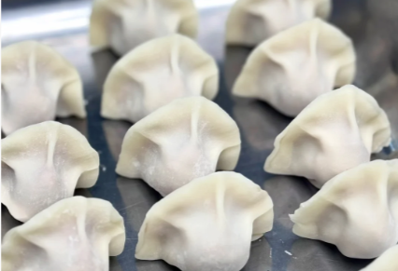
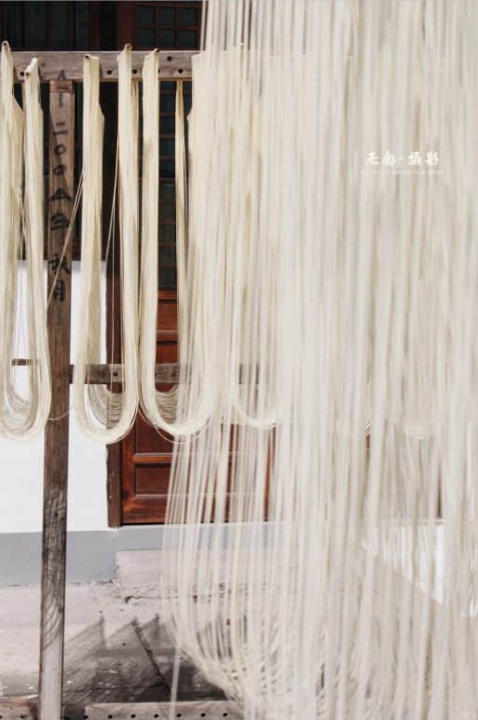
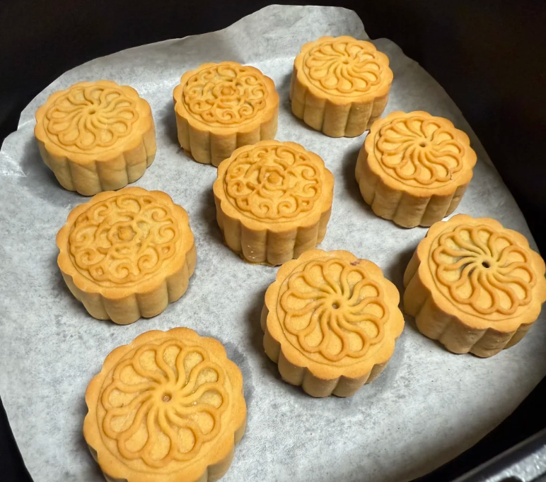
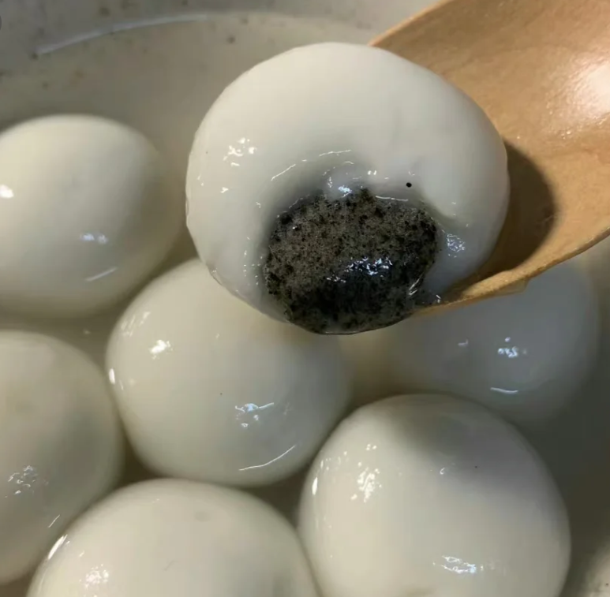
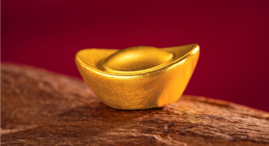
Food and Chinese culture
In traditional Chinese culture, people hope for family reunions, prosperity, longevity and happiness. So people use Chinese food to symbolise these meanings.
Example:
Dumpling - Wealth
Noodles - Longevity
Tangyuan / Mooncake - Reunion
团 圆
Circle
Reunion
Tangyuan
Mooncake
Notes:
元宝：Traditional Chinese Currency
People hope their life as long as noodles。

Slide 10
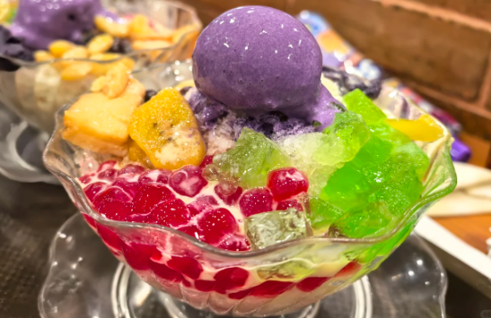
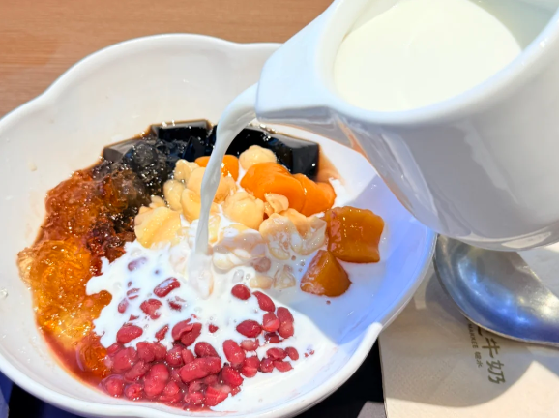
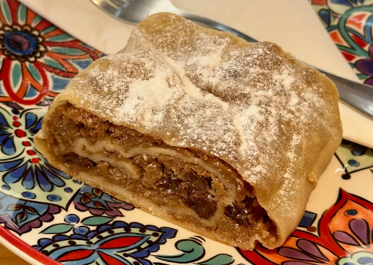
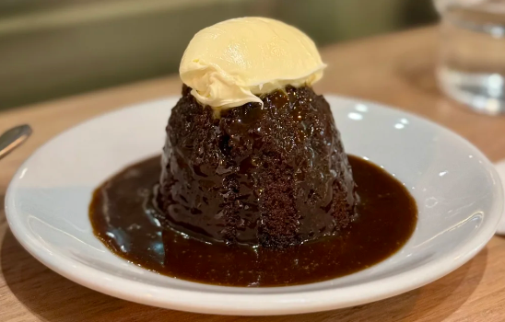
Topic 4 - Dessert
What is dessert：
Sweet food eaten at the end of a meal.
-Cambridge Dictionary
The Impact of the Environment on Desserts in Different area：
Cold area：Desserts in cold area are rich in flavour, warm from being baked, and tend to be high in fat and sugar.
Hot Area：Desserts in hot area are light and refreshing, usually made from fruit, milk and ice.
Reference：Silas (2026). A Taste of the World: Why Desserts Vary Globally. [online] Flavor365. Available at: https://eathealthy365.com/a-taste-of-the-world-why-desserts-vary-globally/ [Accessed 3 Oct. 2026].

Slide 11
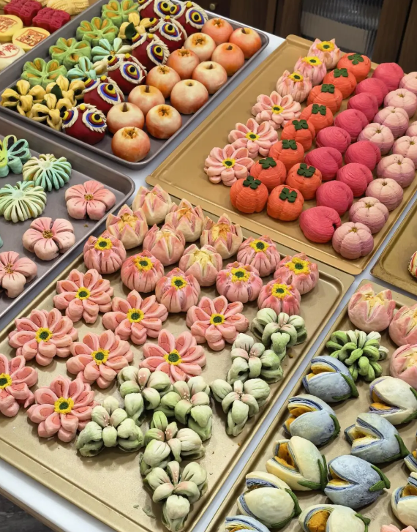
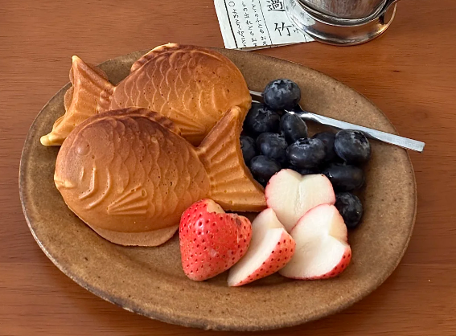
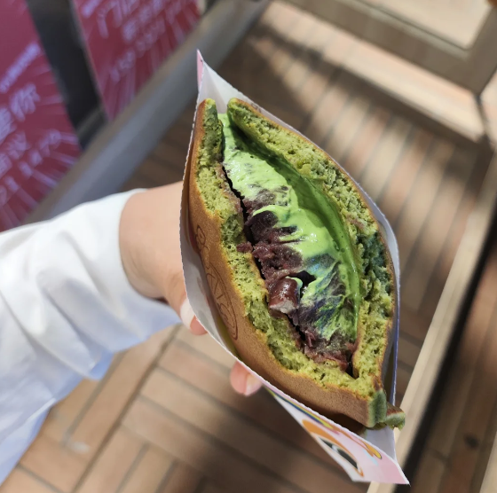
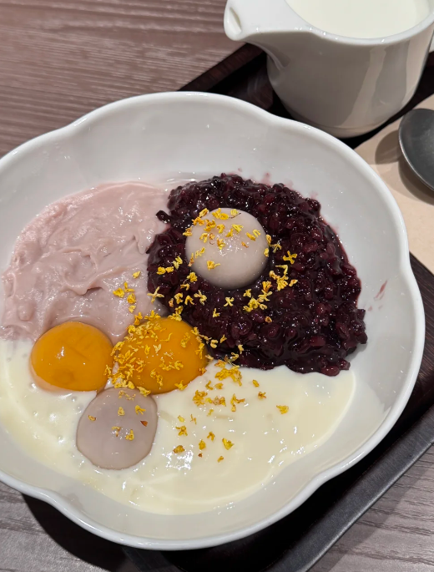
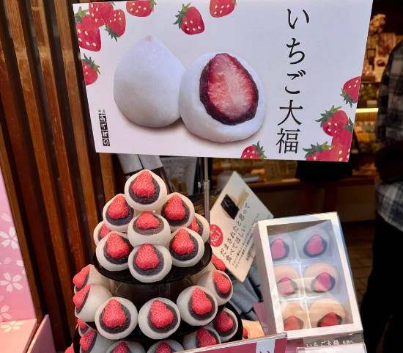
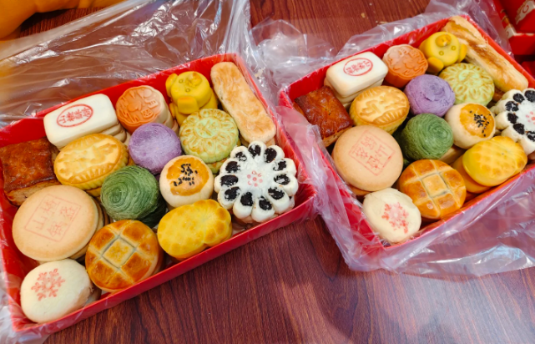
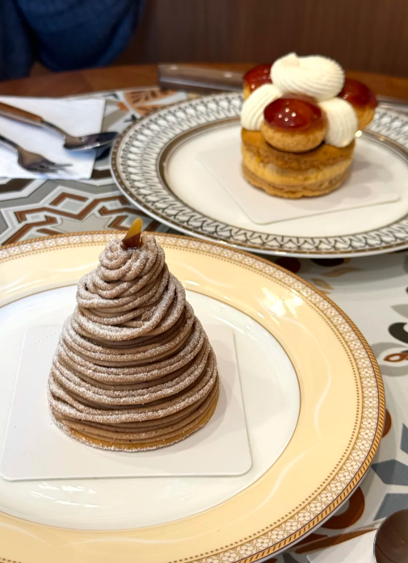
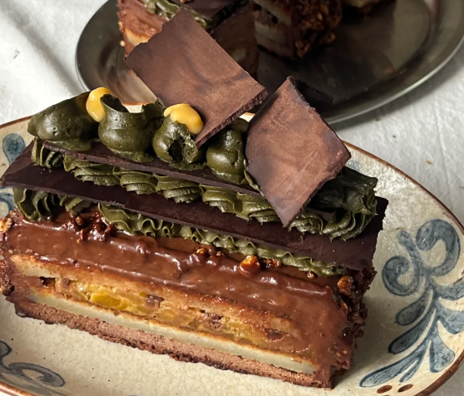
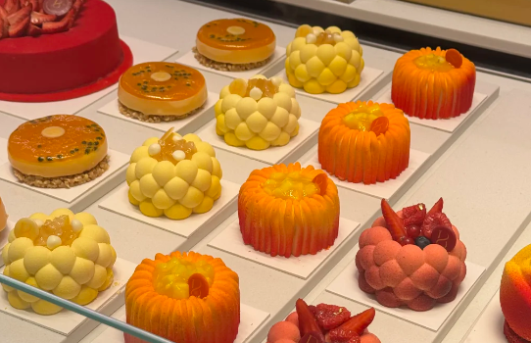
Dessert around the world
Chinese Dessert:
Japanese Dessert：
Japanese desserts are less sweet and have a delicate texture, and are made from beans and rice.
French Dessert：
Chinese desserts tend to be less sweet and are mostly made from beans and rice.
French desserts are high sweet, have a rich creamy flavour, and involve complex preparation techniques.

Slide 12





Dessert and Culture
Because sweetness can evoke feelings of happiness, so people use desserts to symbolise happiness, lucky and love, and to celebrate festivals.
Reference：Pahwa, M. (2026). Why Sweets Are an Important Part of Celebrations Across Cultures? [online] FNP - Official Blog. Available at: https://www.fnp.ae/blog/why-sweets-are-an-important-part-of-celebrations-across-cultures [Accessed 3 Oct. 2026].

